Slide 1
Nudge Design
Day 5
Richard Holden, PhD; Malaz Boustani, MD, MPH
The Faculty of the Agile Nudge University
Supported by NIA
August 2023

Slide 2


DISCLOSURE

Slide 3
Malaz Boustani
Equity Ownership in
RestUp, LLC
Preferred Population Health Management, LLC
Blue Agilis, LLC
DigiCare Realized, Inc
Advisory board member in the past 12 months for :
Biogen, Genentech, Lilly, Merck & Eisai
Author with royalty for
  Agile Implementation Book; The Agile Network Book
Teacher of
  IU Graduate Certificate in Innovation and Implementation Science
Scientist who receive funding from Federal agencies
  NIH
  AHRQ
  CMS

Slide 4




The Impact Equation
ES x I x Sc x St = IS
Impactful
Solution (IS)
x
x
x
=
Effect Size (ES)
Implantability (I)
Scalability (Sc)
Sustainability(St)

Slide 5
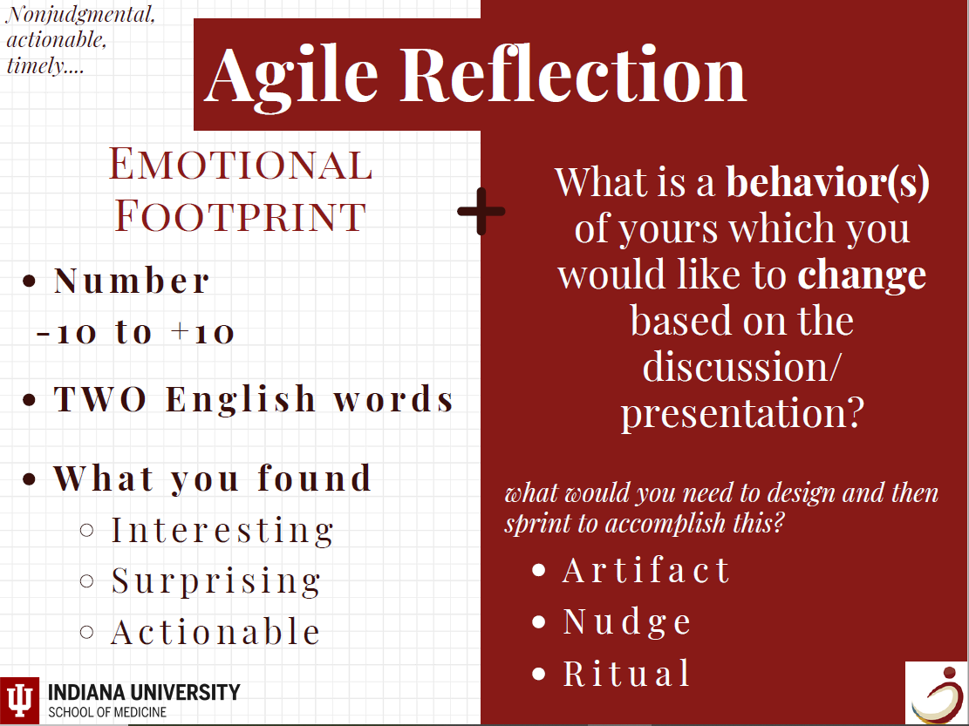

Slide 6
Designing a Nudge
Part 1

Slide 7

Your Journey Starts Here…
Title of Sprint​ | ​
Nudge Label​ | ​
Point Person​ | ​
Date Range of Sprint​ | ​
Link​ | ​
Objective​
​

Slide 8


1.Confirm Demand

Slide 9
Confirm Demand (cont.)
 | [Clear and concise problem statement]
Problem | [confirm demand using quantitative data, attach information here]
Table 1 of 2
Stakeholders Agreement​
[attach signoff date here]​ ​
Table 2 of 2

Slide 10
2.Mapping

Slide 11
Mapping (cont.1)
Map the digital, physical, and social environment surrounding people who are targeted for behavioral changes by answering four questions:

Slide 12
Mapping (cont.2)
Who is the person targeted, what is their current behavior that needs to be changed?
Table 1 of 8
Who are the people interacting with the targeted person, do they have any current behavior that is contributing to the target person's current behavior?
​
Table 2 of 8

Slide 13
Mapping (cont.3)
Is there any existing messenger that could be used as a nudge carrier or a nudge?
Table 3 of 8
Are there any existing digital, physical and social artifacts (or nudges) that are contributing to the current behavior of the targeted person?
​
Table 4 of 8

Slide 14
ADKAR
TERM | Specific Problem
Awareness (what is happening)
Desire (wants)
Knowledge (what is known)
Ability (how)
Reinforcement (why)

Slide 15
Nudge & Stakeholder Agreement
Nudge
[evidence justifying nudge] [provide effect size if evidence has a similar population to the study (use extra slides if needed)
Table 7 of 8
Stakeholders Agreement
[attach signoff date here] ​
Table 8 of 8

Slide 16
3.De-Nudge

Slide 17
De-Nudge
De-Nudge any existing nudges in the current behavior.

Slide 18
4.Search the Cognitive Bias Library

Slide 19
Why Search the Cognitive Bias Library?
Search the cognitive bias library to identify the cognitive bias that might be leveraged to design a Minimally Viable Nudge to accomplish the target behavior.

Slide 20
Thinking Problems
Four thinking problems faced by humans based on 20 cognitive biases of human:
Too much information
Need to act fast
Not enough meaning
Factory Memory

Slide 21
5.Search the Nudge Library

Slide 22
Why to Search the Nudge Library?
Search the Nudge Library to identify existing Minimally Viable Nudge that are based on the cognitive biases that might be leveraged to design a nudge to accomplish the target behavior.

Slide 23
6.Select

Slide 24
Why and What to Select?
Select the milieu of the nudge (digital, physical, social);
Use the MINDSPACE checklist to select the category for designing the Minimally Viable Nudge and then;
Check the compatibility of your Minimally Viable Nudge with the EAST checklist.

Slide 25
The EAST Checklist
The EAST checklist is a way to gauge the potential success of your new nudge prior to testing the new nudge in a series of real-world sprints.
The goal is to make your nudge Easy, Attractive, Social and Timely.

Slide 26
Using the EAST Checklist
For each of the following four items, please use your own judgment to score your nudge compatibility with each item from 1-5.
Sum the scores.
The higher the total score, the more likely your nudge will be successful.
  If you score 15 or higher, your nudge has a good probability of making a behavioral change.

Slide 27
EAST
Easy: Make the nudge easy for people to do; preset options; less effort; simple messages
Attractive: Make the nudge attractive;
something people would want to do; entices
1
2
3
4
5
1
2
3
4
5
Poor
Mediocre
Great
Poor
Mediocre
Great
Social: Title the nudge to something others are also doing; part of the norm; inspires commitment
Timely: Nudge at the most opportune time for receptiveness; immediate costs or benefits
1
2
3
4
5
1
2
3
4
5
Poor
Mediocre
Great
Poor
Mediocre
Great

Slide 28
The MINDSPACE Checklist
This checklist is a quick way to know if your nudge is effective enough to use in a real-world setting.
Each of the items in the next slide, represents a type of nudge or intervention.
  Score each item 1-5 by checking the appropriate score.
  The higher the nudge score the more effective the nudge.
  Score items based on your own judgment.
  If your score is 35 or higher, your nudge is capable of affecting behavioral change.

Slide 29
The MINDSPACE Checklist: MIND
Messenger: We are heavily influenced by who delivers information
Incentives: We are very loss adverse.
1
2
3
4
5
1
2
3
4
5
Poor
Mediocre
Great
Poor
Mediocre
Great
Norms: We are strongly impacted by our perception of what others are doing.
Defaults: We go with the flow and tend not to change preset options given.
1
2
3
4
5
1
2
3
4
5
Poor
Mediocre
Great
Poor
Mediocre
Great

Slide 30
The MINDSPACE Checklist: SPAC
Salience: We are drawn to information perceived to be novel and relevant.
Priming: We are impacted subconsciously by environmental cues.
1
2
3
4
5
1
2
3
4
5
Poor
Mediocre
Great
Poor
Mediocre
Great
Affect: We go with our gut feelings; our first emotional reaction.
Commitments: We seek to follow through on our public promises.
1
2
3
4
5
1
2
3
4
5
Poor
Mediocre
Great
Poor
Mediocre
Great

Slide 31
The MINDSPACE Checklist: E & Scores
Ego: We want to feel good about ourselves.
1
2
3
4
5
Poor
Mediocre
Great
40-45= Grade A- Good to go!​
35-39= Grade B- Proceed, but analyze the key elements that may be weak in MINDSPACE.​
30-34= Grade C- Look for ways to improve the score in the areas that are weak in MINDSPACE.​
25-29= Grade D- Make significant changes to adjust the MINDSPACE and re-score.​
24 or less= Grade F- Make a new plan for the appropriate behavior change.​

Slide 32
7.Define the Termination Plan

Slide 33
Define the Termination Plan
Define a termination plan for both the selected Minimally Viable Nudge as well as a termination plan to stop working on the targeted behavior.

Slide 34
Goal & Evidence-based nudge
Goal
[description of the how you want the nudge to effect behavior]
Table 1 of 6
Evidence-based nudge
​
Table 2 of 6

Slide 35
Description of Evaluation
Description of Evaluation
[description of how you are pulling your data, where and how often]
Table 3 of 6

Slide 36
Who, When, What?
Kill Benchmark: Who, When, What?
[what is the point at which you deem the nudge is causing more harm than necessary(percentage or count lower than current rate) (kill benchmark rates could be from other areas in the journey map)] [description of why you chose that point]
Table 3 of 6

Slide 37
Certifier & Acceptance Benchmark
Kill Certifier
[description of the how you want the nudge to effect behavior]
Table 5 of 6
Acceptance Benchmark
​
Table 6 of 6

Slide 38
8.Run Sprints

Slide 39
Run Sprints
Run a series of Sprints to test the selected Minimally Viable Nudge.

Slide 40
Design the Sprint
What is the task you want to run the print for?
Table 1 of 2
Does this task require one member or multiple members to be accomplished?
If it needs efforts from one member, continue Sprint section up to slide 49. If it needs efforts from multiple members, disregard Sprint slides 42 to 49 and continue from slide 50.
Table 2 of 2

Slide 41
If it needs effort from one member:
How many hours do you think this member needs to work to accomplish this task?
Table 1 of 14
You are a human, so multiply this number by 2, since humans are always optimistic
Table 2 of 14

Slide 42
If it needs efforts from one member:
Decide the length of the task completion per a day
Divided the final number of hours from the previous slide, by the number of hours available for this member per a day to calculate how many days does this task need to be accomplished by this member: (Keep it in your mind that this member is also a “human” and have other needs than doing this task. So, it might be a good choice to dedicate less than 8 hours per a day for this task)
Table 3 of 14

Slide 43
Design
Design the sprint by filling tables on the following slides:

Slide 44
Localize Nudge MVP (Minimum Viable Product)
Description of Minimally Viable Nudge
Table 4 of 14
Length of the SPRINT (the experiment)
[include extra slides if needed with more information about how the sprint will be run (example: include speeches, how you will reach out, how often, more detailed the better)]
Table 5 of 14

Slide 45
Implement Sprints
Start Date
Table 6 of 14
End Date
Table 7 of 14

Slide 46
Implement Sprints (cont.)
Evaluate Date
[this is a space to add more information when action items are getting done] [if there are themes or problems that are starting to show up] [this is a place for qualitative data as well]
Table 8 of 14

Slide 47
Monitor Impacts
Goal
Table 11 of 14
Results
[Refer back to step 3 to present data]
Table 12 of 14

Slide 48
Establish MSOP (Minimally Standard Operating Procedure)
Goal
Table 11 of 14
Results
[Refer back to step 3 to present data]
Table 12 of 14

Slide 49
If it needs efforts from multiple members (1):
Define the Minimally Viable Members to complete the task
Table 1 of 16
Decide if these Minimally Viable Members need to be present and work on the task simultaneously or not
If they need to be present simultaneously you need to design a team sprint. If they don’t need to be present simultaneously you need to design a rely sprint.
Table 2 of 16

Slide 50
If it needs efforts from multiple members (2):
What are the functionalities of each member?
Write separately for each member
Table 3 of 16

Slide 51
If it needs efforts from multiple members (3):
How many hours do you think each of these members need to work to accomplish this task?
Write separately for each member
Table 4 of 16

Slide 52
If it needs efforts from multiple members (4):
Decide the length of the task completion per a day
Divide the final number of hours from the previous slide, by the number of hours available for each member per a day to calculate how many days does this task need to be accomplished by each and all the members: (Keep it in your mind that this member is also a “human” and have other needs than doing this task. So, it might be a good choice to dedicate less than 8 hours per a day for this task)
Table 5 of 16

Slide 54
Utilizing a Nudge
Part 3

Slide 55
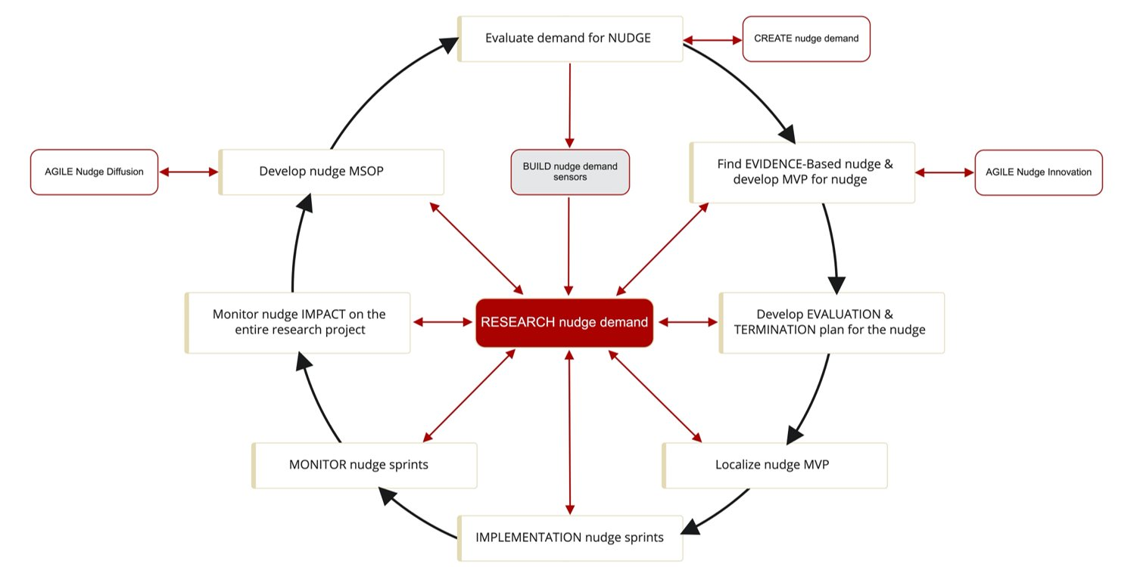
Agile Implementation

Slide 56
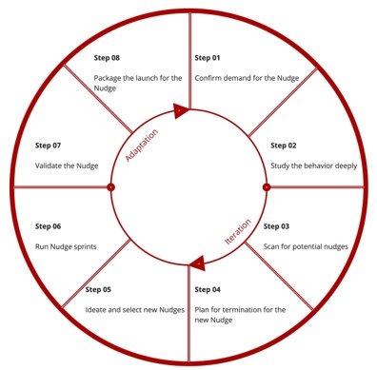
Agile Innovation

Slide 57

Smart allocation of Time- Using Sprints
Sprint/Solve a Problem
Team Sprint: Each team member must be present at the same time
Relay Sprint: Hand-off from one person to another
Time & Space
Building relationship
Weekly Huddle
Review Scorecard & reflect & adjust sprint

