Slide 1
Research Recruitment and Retention (R³) Nudge Unit
Day 4
Richard Holden, PhD; Malaz Boustani, MD, MPH
The Faculty of the Agile Nudge University
Supported by NIA
August 2023

Slide 2
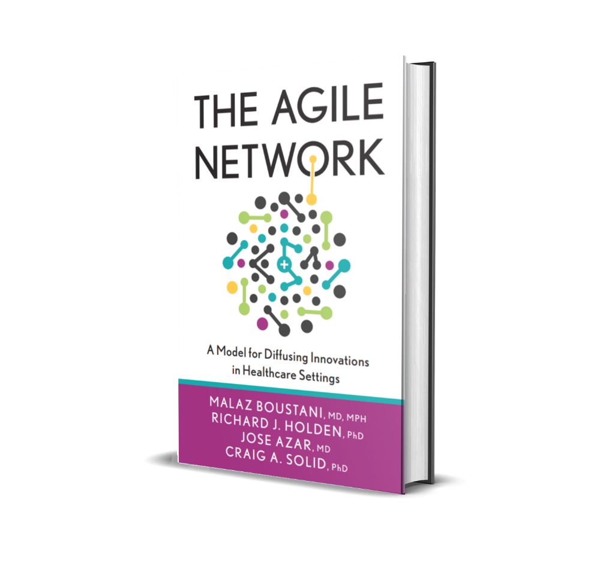

DISCLOSURE

Slide 3
Malaz Boustani
Equity Ownership in
RestUp, LLC
Preferred Population Health Management, LLC
Blue Agilis, LLC
DigiCare Realized, Inc
Advisory board member in the past 12 months for :
Biogen, Genentech, Lilly, Merck & Eisai
Author with royalty for
  Agile Implementation Book; The Agile Network Book
Teacher of
  IU Graduate Certificate in Innovation and Implementation Science
Scientist who receive funding from Federal agencies
  NIH
  AHRQ
  CMS

Slide 4




The Impact Equation
ES x I x Sc x St = IS
Impactful
Solution (IS)
x
x
x
=
Effect Size (ES)
Implantability (I)
Scalability (Sc)
Sustainability(St)

Slide 5
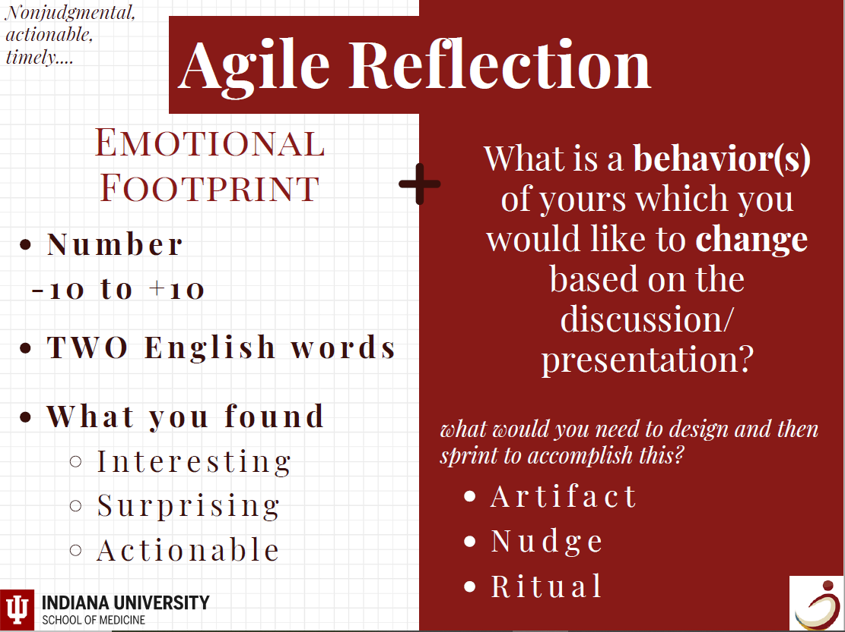

Slide 6
Part 1
R³ Nudge University

Slide 7
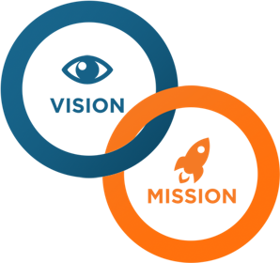
WHAT IS R³ NUDGE U
MISSION:
Build a repository of evidence-based nudges to recruit and retain human subjects into clinical research studies.
VISION:
To be the world’s leading resource for designing and implementing effective nudges in recruitment and retention in clinical research.

Slide 8

Values
Excellence and Precision in research
Charity, equality and justice in research
Mutual trust and respect
Emotional and psychological safety
Efficiency
Notes:
Values
Total patient care, including mind, body and spirit
Excellence in education and research
Interdisciplinary collaboration
Quality of care and respect for life of all
Charity, equality and justice in health care
Leadership in health promotion and wellness
An internal community of mutual trust and respect

Slide 9
R³ NUDGE Goals
Conquer recruitment barriers with evidence-based solutions.
Increase retention and participation in research studies.
Create fans of research.
Collaborate with healthcare leaders to promote positive change.
Discover new nudges.
Add innovated nudges to our Research Nudge Library.
Use Agile Diffusion to spread our methods to the community.
Notes:
Use innovative care, education, and research to facilitate transformation of the healthcare system. Prepare health care professionals for the complex health care environment and care of today's patients in a safe, competent manner.
Within NudgeU, activities and simulations will be developed to promote interdisciplinary, collaborative care among the health care practitioners.
NudgeU will provide authentic experiences to test strategies, and prepare and assess learners using simulations in a variety of platforms, e.g. patient simulators, actors/actresses, virtual reality multimedia, and other methods.
NudgeU will consult with leaders to conduct problem assessments and recommend cognitive, psychomotor, and affective solutions.

Slide 10
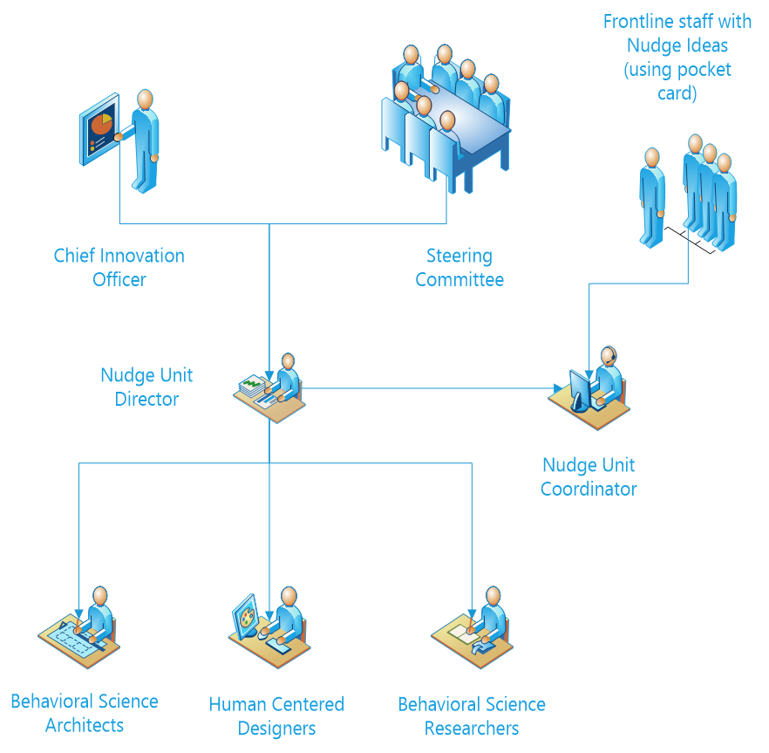

R³ NUDGE Organizational Structure
CHIIS Director
Steering Committee
Nudge Unit
Team
(Coordinator, Director)
Local Research Team
Behavioral Science Architects
Human Centered Designers
Behavioral Science Researchers

Slide 11
Part 2
Agile Methodology of the Nudge Unit

Slide 12

Agile Methodology for R³ Nudge Unit (1)
Flying The Plane While Building It
Select existing evidence-based nudge and localize for specific project using Agile Implementation.
If no existing nudge, use Agile Innovation to create one.
Use Agile Diffusion to share minimally standard operating procedure (MSOP).

Slide 13
Agile Methodology for R³ Nudge Unit (2)
  Flying The Plane While Building It
  Planning Phase – 10%
    Map the journey – GPS – Dashboard.
    Create a termination plan.
      Who?
      When?
      What criteria?
        What is the current performance (success) ?
        See if there already an existing evidence-based nudge?
        Terminate solution (nudge) or problem?

Slide 14
Agile Methodology for R³ Nudge Unit (3)
  Flying The Plane While Building It
  Execution Phase – 90%​
    Use the first minimally viable protocol (MVP) ​
    Sprint – start flying​
    Frequent redesign

Slide 15
Part 3
Agile Implementation, Innovation and Nudge Design

Slide 16
AGILE Implementation ​
Evaluate demand for nudge
Create nudge demand
Agile Nudge Diffusion
Develop nudge MSOP
Build nudge demand sensors
Find evidence-based nudge and develop MVP for nudge
Agile Nudge Innovation
Monitor nudge impact on the entire research project
Reassess nudge demand
Develop evaluation and termination plan for the nudge
Monitor nudge sprints
Localize nudge MVP
Implementation nudge sprints

Slide 17
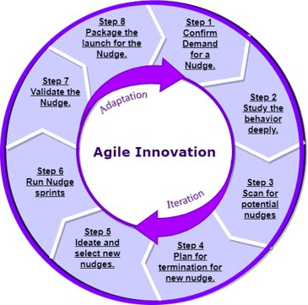
AGILE Innovation ​
Notes:
Our overall goals are to use innovation (click), education (click), and research (click) to facilitate transformation of the HealthCare system.

Slide 18
How to Design a Nudge | Agile Innovation (1)​
Map the digital, physical, and social environment surrounding the people who are targeted for behavioral changes:​
  Who is the person who is targeted, what is their current behavior that needs to be changed?​
  Who are the people interacting with the targeted person and do they have any behavior that is contributing to the current problem behavior of the target person?​
  Is there any existing messenger that could be used as nudge carrier or a nudge?​
  Are there any existing digital, physical and social artifacts (or nudges) that are contributing to the problem behavior of the targeted person?​
2. De-Nudge any existing nudges to the current problem behavior​
​

Slide 19
How to Design a Nudge | Agile Innovation (2)​
Search the cognitive bias library to identify the cognitive biases or heuristics that are contributing to the existing problem behavior or the cognitive bias that may lead to the targeted behavior.​
Search the Nudge Library to identify existing nudges that are based on the cognitive biases contributing to the targeted behavior to overcome or find the existing nudge that are based on cognitive bias that may lead to the targeted behavior.​
​

Slide 20
How to Design a Nudge | Agile Innovation (3)​
Select existing Nudge to test its compatibility with MINDSPACE checklist and ​EAST checklist.​
If there is no evidence-based Nudge to test, then:​
    select a cognitive bias to build on a new nudge ​
    select the milieu of the nudge (digital, physical, social); ​
    use the MINDSPACE to select a category of nudge to design; ​
    create the first MVP nudge an
    d check its compatibility with EAST.​

Slide 21
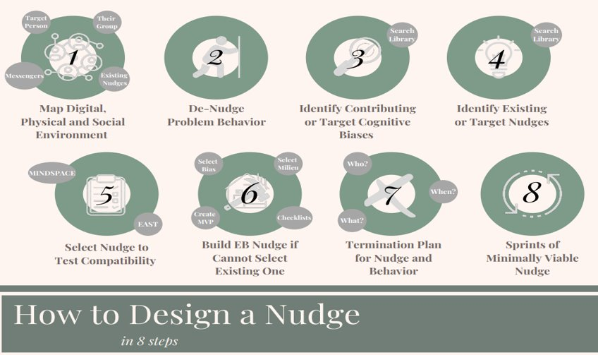
How to Design a Nudge?

Slide 22
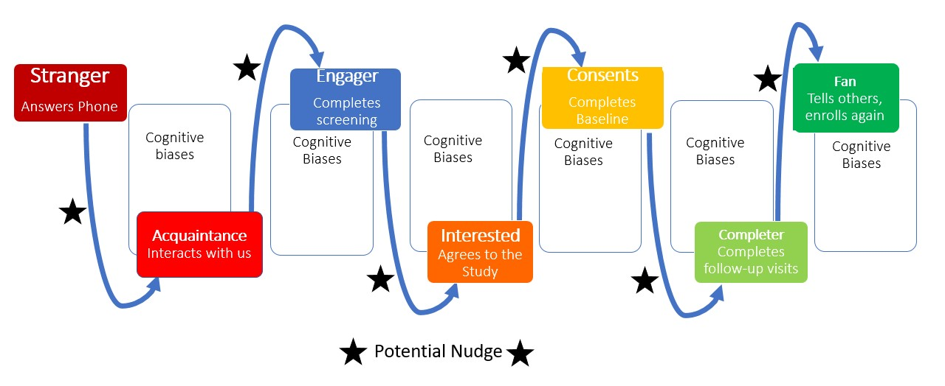
Recruitment and Retention Journey Map​

Slide 23
Cognitive Biases
Removed nudges
Modified or New Nudges
Existing Behaviors
Behavior
Existing Nudges
Behavior
Cognitive Biases
Cognitive Biases

Slide 24

Library of Nudges
Cognitive Bias
Nudge
Behavior
Library of Nudges

Slide 25
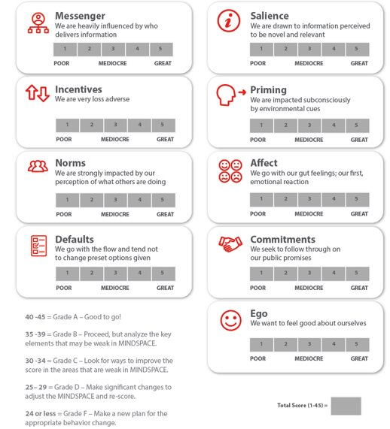
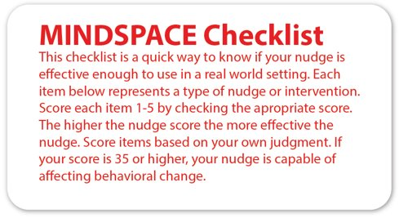
MINDSPACE Checklist

Slide 26
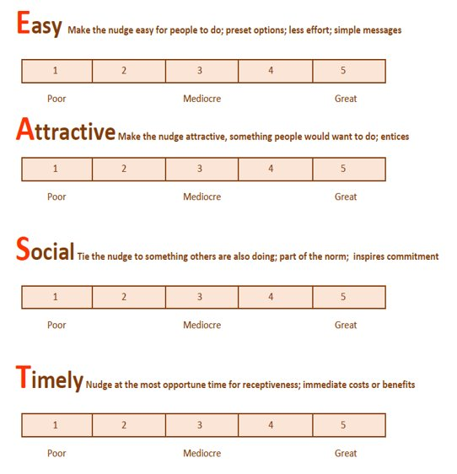
EAST Checklist
The EAST checklist is a way to gauge the potential success of your new nudge prior to testing the new nudge in a series of real-world sprints. The goal is to make your nudge Easy, Attractive, Social and Timely. For each of the following four items, please use your own judgment to score your nudge compatibility with each item from 1-5. Sum the scores. The higher the total score, the more likely your nudge will be successful. If you score 15 or higher, your nudge has a good probability of making a behavioral change. ​

Slide 27
How to Design a Nudge (Agile Innovation)​
Define a termination plan for both the selected or the new nudge and define a termination plan for stop working on the targeted behavior.​
  Who will make the decision to terminate?​
  When will the decision be made?​
  What criteria will be used?​
Run a series of Sprints to test the selected or designed minimally viable Nudge.​

Slide 28
Tools
Nudge Library​
Cognitive Biases Library​
Recruitment Bootcamp​
Retention Bootcamp​
Artifacts

Slide 29
Nudge Library​
Will contain evidence-based nudges gathered by​
  Reviewing the literature​
  Discussions with colleagues​
Build and maintain the nudge library for the evidence-based nudge unit​
If you don’t have an evidence-based nudge, use Agile Innovation to design one!​

