Slide 1
Nudge 101
Day 3
Richard Holden, PhD; Malaz Boustani, MD, MPH
The Faculty of the Agile Nudge University
Supported by NIA
April 2023

Slide 2
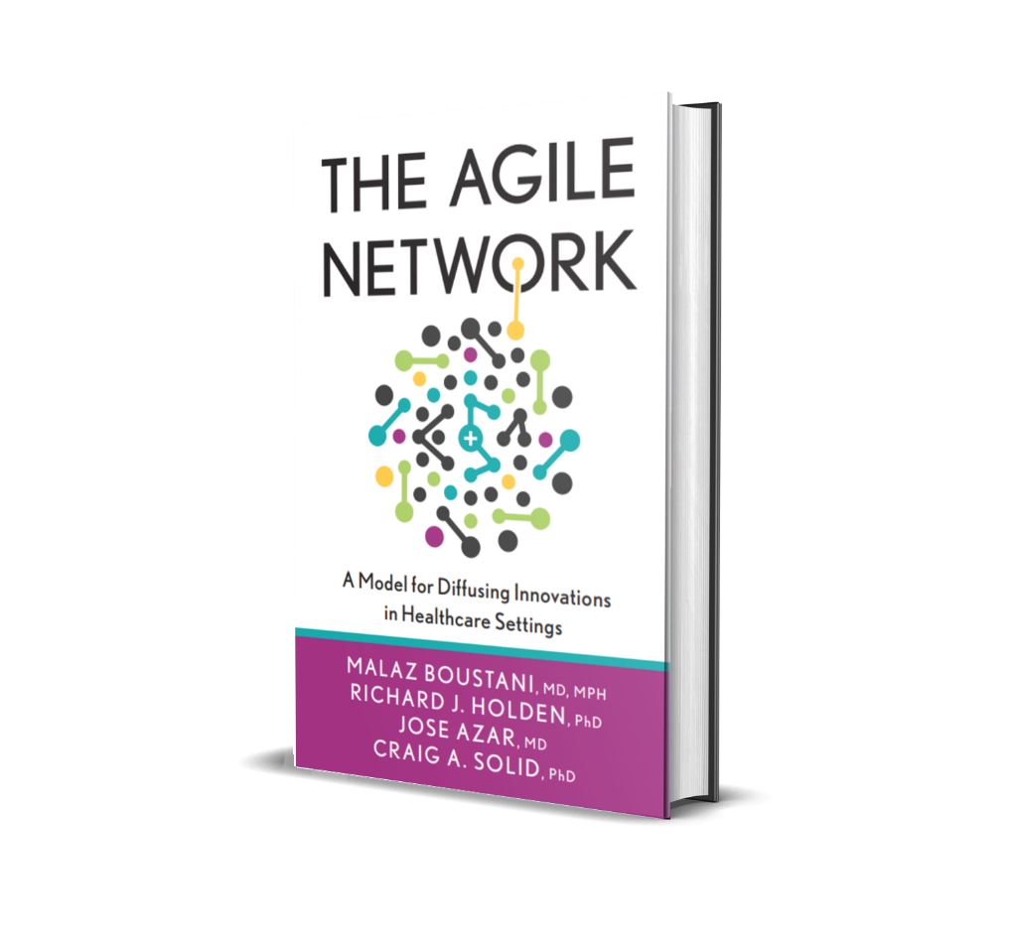

DISCLOSURE

Slide 3
Malaz Boustani
Equity Ownership in
RestUp, LLC
Preferred Population Health Management, LLC
Blue Agilis, LLC
DigiCare Realized, Inc
Advisory board member in the past 12 months for :
Biogen, Genentech, Lilly, Merck & Eisai
Author with royalty for
  Agile Implementation Book; The Agile Network Book
Teacher of
  IU Graduate Certificate in Innovation and Implementation Science
Scientist who receive funding from Federal agencies
  NIH
  AHRQ
  CMS

Slide 4




The Impact Equation
ES x I x Sc x St = IS
Impactful
Solution (IS)
x
x
x
=
Effect Size (ES)
Implantability (I)
Scalability (Sc)
Sustainability(St)

Slide 5
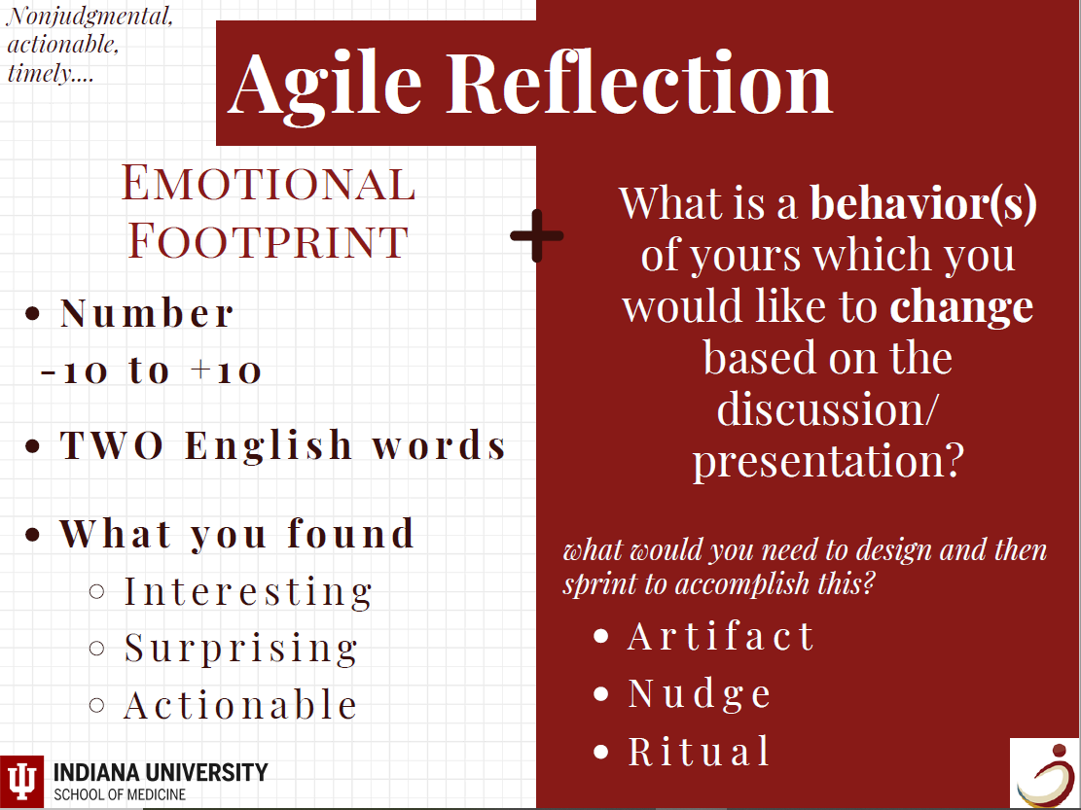

Slide 6
Nudge
Part 1
The Case of Reducing CLABSIs

Slide 7
The Case of Reducing CLABSI’s
The Need: Healthcare delivery systems face increasing challenges in an industry that is constantly innovating. In order to achieve the triple aim of better care and better health at lower costs, the IU Health Academic Health Center recognized the need to become a more adaptive system. They knew that certain evidence-based solutions existed to help them deliver better health to their patients, but they were not expecting the benefits of those solutions due to lack of implementation. The incidence rate of Central Line Associated Blood Stream Infections (CLABSIs) was an area of focus prioritized throughout this implementation.
Implementation: The IU Health Academic Health Center embraced the opportunity to become a learning healthcare system as they sought to address their highest safety priority for 2016: reducing Central Line Associated Blood Stream Infections by twenty percent. With the help of the Center for Health Innovation and Implementation Science (CHIIS), they strategically implemented interventions supported by evidence-based and statistical methods in order to bring about the needed change.
Successful Outcome: Not only did the Academic Health Center achieve better care and better health by improving specific performance measures, but they improved their costs savings and became more effective at implementing positive changes within the complex adaptive system of healthcare.

Slide 8
Executive Summary
The problems faced by most healthcare systems are four-fold, with the needs to improve patient care and overall health, lower costs, and increase physician engagement. Addressing these issues simultaneously can prove a daunting task, as implementing sustainable organizational change within any healthcare organization requires additional effort to be made. To adapt to the many changes in the healthcare system, however, it was worthwhile to IU Health’s leadership to make internal changes in order to improve performance outcomes and equip them for long term success. Targeted within their intervention was the rate of Central Line Associated Blood Stream Infections (CLABSIs). The IU Health Academic Health Center partnered with CHIIS to accomplish the goal of reducing the incidence of CLABSIs by 20% while simultaneously creating a culture of continuous learning within their health system. After identifying the best solutions and implementing them strategically within their organization, the Center experienced impressive results. They not only reduced the CLABSI incidence rate overall to surpass their goal, but they saw a decrease in the average number of harm events during the project. They also gained a deeper understanding of their delivery system.

Slide 9
The Need
Ever since partnering with the nation’s largest medical school, IU Health has had access to a wealth of health innovations and resources from which to learn. Being able to function as a learning healthcare system became an exceedingly important ambition for the Academic Health Center at IU Health in 2016. Continuous improvement ought to be an aspiration of every organization, but it is perhaps the most meaningful pursuit for healthcare organizations. The IU Health Academic Health Center made it an area of focus in 2016 to improve their highest safety priority for their patients. They chose to concentrate their efforts on directly reducing CLABSIs and fostering a culture of organizational learning to reach their goal. Taking steps to become a learning healthcare system was the logical choice for the Academic Health Center in fulfilling their mission to provide quality care in the midst of a complex and dynamically changing industry.

Slide 10
Implementation
The IU Health Academic Health Center employed strategies from CHIISe to address the need of becoming a “learning healthcare delivery system.” These strategies included conducting Innovation Forums and implementing the Reflective Adaptive Process to bring about change. In addition, the Four Disciplines of Execution (4DX) were used as a concept adapted within the Agile Implementation process throughout the project. Central Line Guidelines were developed, and 300 physicians and 1,000 nurses were trained on this curriculum within an 8-month period. Clinical staff formed a Reflective Adaptive Process (RAP) team, which provided an outlet for collaboration on process improvement. Statistical analysis was performed to determine incidence rates and to track compliance. Evidence-based literature was reviewed and applied to arrive at the most sustainable, reliable standard operating procedure. As CHIIS guided the implementation process, the teams became more informed about what worked best within their local system.

Slide 11
The Outcome
At the conclusion of the project, the IU Health Academic Health Center reported substantial improvements. The CLABSI incidence rate decreased by 28% during the sustainment period as compared to the baseline. In addition, the Central Line bundle increased in compliance from 64% at baseline to 87% during the sustainment period. The solutions implemented increased physician engagement and helped the Center to become a learning system by providing valuable insights into their local healthcare delivery environment. One surprising discovery was the importance of changing the physician’s perception to one of collaboration and organizational learning rather than punitive in order to improve overall care. The process of CHIIS’s Agile Implementation is able to highlight helpful social changes like these, as well as direct process changes, because of its comprehensive approach. CHIIS provided the tools for implementing sustainable change within the increasingly complex system of healthcare. The IU Health Academic Health Center achieved lasting, effective transformation that translated into a fulfillment of the Quadruple Aim of healthcare: increased clinician engagement, improved care, improved health, at lower costs.

Slide 12



Why Nudge?
To change the behavior of
Yourself A loved one A group of Individuals

Slide 13
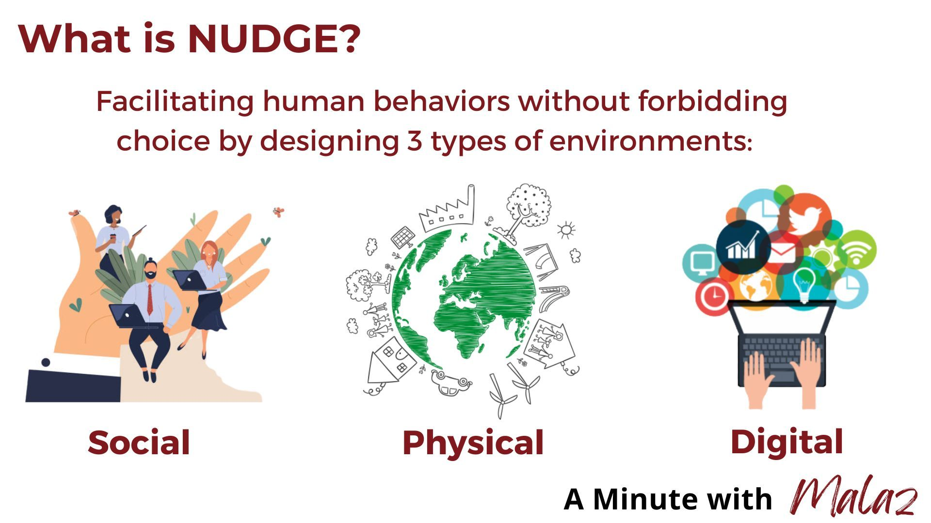
What’s NUDGE?
Architecting the social, physical and digital environment to facilitate certain behaviors without forbidding choice.
Social
Physical
Digital
Richard H. Thaler and Cass R. Sunstein, 2008. Nudge.

Slide 14

Description of Nudge
Notes:
Arranging the choices or environment in such a manner that things are drawn or stand out from others – against the environment.

Slide 15




Building Blocks for Nudge Design
Mapping the Environment
Digital
Physical
Social
Search the library
Cognitive Biased Library
Existing Nudge Library
Run Sprint & Reflect

Slide 16
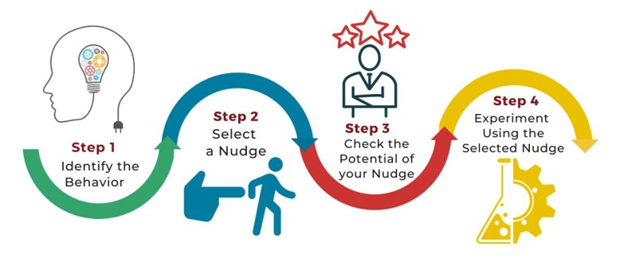
How to Nudge: Step-by-Step Process

Slide 17
Agile Cycle
Sprint 90%
Plan, Reflect & Adjust 10%
Demand

Slide 18
The Story of Reducing CLABSIs
Central line-associated bloodstream infections (CLABSIs) affected roughly 80,000 patients per year and require hundreds of millions of dollars to treat.

Slide 19
Takeaways
  The intervention impacted behavior and care delivery across the system for a variety of harms.
  Individuals’ interactions are complex and are a function of their uniqueness.
  A successful intervention allows for complexity, but also leverages it to maximize the impact.

Slide 20
Designing a Nudge
Part 2

Slide 21

Your Journey Starts Here…
Title of Sprint​ | ​
Nudge Label​ | ​
Point Person​ | ​
Date Range of Sprint​ | ​
Link​ | ​
Objective​
​

Slide 22


1.Confirm Demand

Slide 23
Confirm Demand (cont.)
 | [Clear and concise problem statement]
Problem | [confirm demand using quantitative data, attach information here]
Table 1 of 2
Stakeholders Agreement​
[attach signoff date here]​ ​
Table 2 of 2

Slide 24
2.Mapping

Slide 25
Mapping (cont.1)
Map the digital, physical, and social environment surrounding people who are targeted for behavioral changes by answering four questions:

Slide 26
Mapping (cont.2)
Who is the person targeted, what is their current behavior that needs to be changed?
Table 1 of 8
Who are the people interacting with the targeted person, do they have any current behavior that is contributing to the target person's current behavior?
​
Table 2 of 8

Slide 27
Mapping (cont.3)
Is there any existing messenger that could be used as a nudge carrier or a nudge?
Table 3 of 8
Are there any existing digital, physical and social artifacts (or nudges) that are contributing to the current behavior of the targeted person?
​
Table 4 of 8

Slide 28
ADKAR
TERM | Specific Problem
Awareness (what is happening)
Desire (wants)
Knowledge (what is known)
Ability (how)
Reinforcement (why)

Slide 29
Nudge & Stakeholder Agreement
Nudge
[evidence justifying nudge] [provide effect size if evidence has a similar population to the study (use extra slides if needed)
Table 7 of 8
Stakeholders Agreement
[attach signoff date here] ​
Table 8 of 8

Slide 30
3.De-Nudge

Slide 31
De-Nudge
De-Nudge any existing nudges in the current behavior.

Slide 32
4.Search the Cognitive Bias Library

Slide 33
Why Search the Cognitive Bias Library?
Search the cognitive bias library to identify the cognitive bias that might be leveraged to design a Minimally Viable Nudge to accomplish the target behavior.

Slide 34
Thinking Problems
Four thinking problems faced by humans based on 20 cognitive biases of human:
Too much information
Need to act fast
Not enough meaning
Factory Memory

Slide 35
5.Search the Nudge Library

Slide 36
Why to Search the Nudge Library?
Search the Nudge Library to identify existing Minimally Viable Nudge that are based on the cognitive biases that might be leveraged to design a nudge to accomplish the target behavior.

Slide 37
6.Select

Slide 38
Why and What to Select?
Select the milieu of the nudge (digital, physical, social);
Use the MINDSPACE checklist to select the category for designing the Minimally Viable Nudge and then;
Check the compatibility of your Minimally Viable Nudge with the EAST checklist.

Slide 39
The EAST Checklist
The EAST checklist is a way to gauge the potential success of your new nudge prior to testing the new nudge in a series of real-world sprints.
The goal is to make your nudge Easy, Attractive, Social and Timely.

Slide 40
Using the EAST Checklist
For each of the following four items, please use your own judgment to score your nudge compatibility with each item from 1-5.
Sum the scores.
The higher the total score, the more likely your nudge will be successful.
  If you score 15 or higher, your nudge has a good probability of making a behavioral change.

Slide 41
EAST
Easy: Make the nudge easy for people to do; preset options; less effort; simple messages
Attractive: Make the nudge attractive;
something people would want to do; entices
1
2
3
4
5
1
2
3
4
5
Poor
Mediocre
Great
Poor
Mediocre
Great
Social: Title the nudge to something others are also doing; part of the norm; inspires commitment
Timely: Nudge at the most opportune time for receptiveness; immediate costs or benefits
1
2
3
4
5
1
2
3
4
5
Poor
Mediocre
Great
Poor
Mediocre
Great

Slide 42
The MINDSPACE Checklist
This checklist is a quick way to know if your nudge is effective enough to use in a real-world setting.
Each of the items in the next slide, represents a type of nudge or intervention.
  Score each item 1-5 by checking the appropriate score.
  The higher the nudge score the more effective the nudge.
  Score items based on your own judgment.
  If your score is 35 or higher, your nudge is capable of affecting behavioral change.

Slide 43
The MINDSPACE Checklist: MIND
Messenger: We are heavily influenced by who delivers information
Incentives: We are very loss adverse.
1
2
3
4
5
1
2
3
4
5
Poor
Mediocre
Great
Poor
Mediocre
Great
Norms: We are strongly impacted by our perception of what others are doing.
Defaults: We go with the flow and tend not to change preset options given.
1
2
3
4
5
1
2
3
4
5
Poor
Mediocre
Great
Poor
Mediocre
Great

Slide 44
The MINDSPACE Checklist: SPAC
Salience: We are drawn to information perceived to be novel and relevant.
Priming: We are impacted subconsciously by environmental cues.
1
2
3
4
5
1
2
3
4
5
Poor
Mediocre
Great
Poor
Mediocre
Great
Affect: We go with our gut feelings; our first emotional reaction.
Commitments: We seek to follow through on our public promises.
1
2
3
4
5
1
2
3
4
5
Poor
Mediocre
Great
Poor
Mediocre
Great

Slide 45
The MINDSPACE Checklist: E & Scores
Ego: We want to feel good about ourselves.
1
2
3
4
5
Poor
Mediocre
Great
40-45= Grade A- Good to go!​
35-39= Grade B- Proceed, but analyze the key elements that may be weak in MINDSPACE.​
30-34= Grade C- Look for ways to improve the score in the areas that are weak in MINDSPACE.​
25-29= Grade D- Make significant changes to adjust the MINDSPACE and re-score.​
24 or less= Grade F- Make a new plan for the appropriate behavior change.​

Slide 46
7.Define the Termination Plan

Slide 47
Define the Termination Plan
Define a termination plan for both the selected Minimally Viable Nudge as well as a termination plan to stop working on the targeted behavior.

Slide 48
Goal & Evidence-based nudge
Goal
[description of the how you want the nudge to effect behavior]
Table 1 of 6
Evidence-based nudge
​
Table 2 of 6

Slide 49
Description of Evaluation
Description of Evaluation
[description of how you are pulling your data, where and how often]
Table 3 of 6

Slide 50
Who, When, What?
Kill Benchmark: Who, When, What?
[what is the point at which you deem the nudge is causing more harm than necessary(percentage or count lower than current rate) (kill benchmark rates could be from other areas in the journey map)] [description of why you chose that point]
Table 3 of 6

Slide 51
Certifier & Acceptance Benchmark
Kill Certifier
[description of the how you want the nudge to effect behavior]
Table 5 of 6
Acceptance Benchmark
​
Table 6 of 6

Slide 52
8.Run Sprints

Slide 53
Run Sprints
Run a series of Sprints to test the selected Minimally Viable Nudge.

Slide 54
Design the Sprint
What is the task you want to run the print for?
Table 1 of 2
Does this task require one member or multiple members to be accomplished?
If it needs efforts from one member, continue Sprint section up to slide 49. If it needs efforts from multiple members, disregard Sprint slides 42 to 49 and continue from slide 50.
Table 2 of 2

Slide 55
If it needs effort from one member:
How many hours do you think this member needs to work to accomplish this task?
Table 1 of 14
You are a human, so multiply this number by 2, since humans are always optimistic
Table 2 of 14

Slide 56
If it needs efforts from one member:
Decide the length of the task completion per a day
Divided the final number of hours from the previous slide, by the number of hours available for this member per a day to calculate how many days does this task need to be accomplished by this member: (Keep it in your mind that this member is also a “human” and have other needs than doing this task. So, it might be a good choice to dedicate less than 8 hours per a day for this task)
Table 3 of 14

Slide 57
Design
Design the sprint by filling tables on the following slides:

Slide 58
Localize Nudge MVP (Minimum Viable Product)
Description of Minimally Viable Nudge
Table 4 of 14
Length of the SPRINT (the experiment)
[include extra slides if needed with more information about how the sprint will be run (example: include speeches, how you will reach out, how often, more detailed the better)]
Table 5 of 14

Slide 59
Implement Sprints
Start Date
Table 6 of 14
End Date
Table 7 of 14

Slide 60
Implement Sprints (cont.)
Evaluate Date
[this is a space to add more information when action items are getting done] [if there are themes or problems that are starting to show up] [this is a place for qualitative data as well]
Table 8 of 14

Slide 61
Monitor Impacts
Goal
Table 11 of 14
Results
[Refer back to step 3 to present data]
Table 12 of 14

Slide 62
Establish MSOP (Minimally Standard Operating Procedure)
Goal
Table 11 of 14
Results
[Refer back to step 3 to present data]
Table 12 of 14

Slide 63
If it needs efforts from multiple members (1):
Define the Minimally Viable Members to complete the task
Table 1 of 16
Decide if these Minimally Viable Members need to be present and work on the task simultaneously or not
If they need to be present simultaneously you need to design a team sprint. If they don’t need to be present simultaneously you need to design a rely sprint.
Table 2 of 16

Slide 64
If it needs efforts from multiple members (2):
What are the functionalities of each member?
Write separately for each member
Table 3 of 16

Slide 65
If it needs efforts from multiple members (3):
How many hours do you think each of these members need to work to accomplish this task?
Write separately for each member
Table 4 of 16

Slide 66
If it needs efforts from multiple members (4):
Decide the length of the task completion per a day
Divide the final number of hours from the previous slide, by the number of hours available for each member per a day to calculate how many days does this task need to be accomplished by each and all the members: (Keep it in your mind that this member is also a “human” and have other needs than doing this task. So, it might be a good choice to dedicate less than 8 hours per a day for this task)
Table 5 of 16

Slide 68
Utilizing a Nudge
Part 3

Slide 69
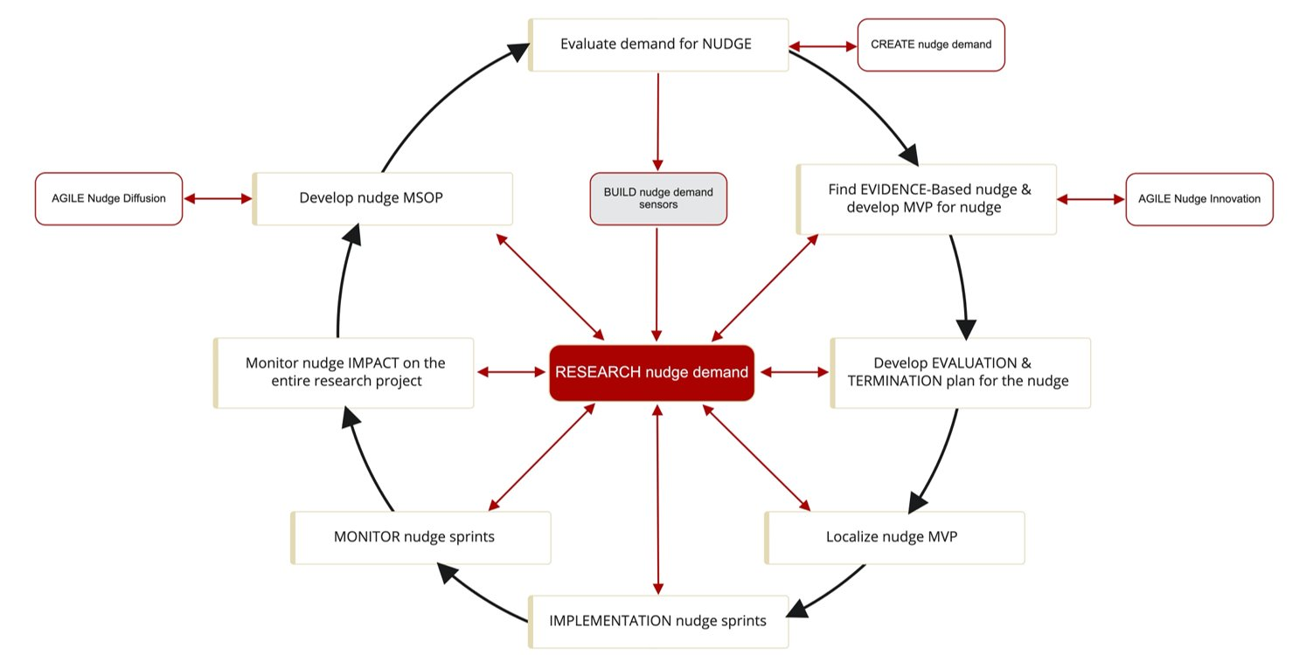
Agile Implementation

Slide 70
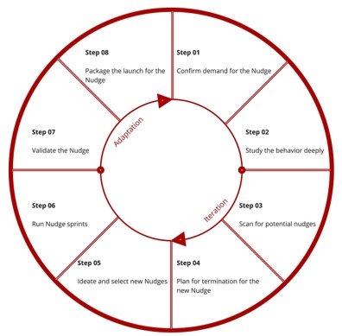
Agile Innovation

Slide 71

Smart allocation of Time- Using Sprints
Sprint/Solve a Problem
Team Sprint: Each team member must be present at the same time
Relay Sprint: Hand-off from one person to another
Time & Space
Building relationship
Weekly Huddle
Review Scorecard & reflect & adjust sprint

