Slide 1
Agile Processes Day 2
Richard Holden, PhD; Malaz Boustani, MD, MPH
The Faculty of the Agile Nudge University
Supported by NIA
April 2023

Slide 2
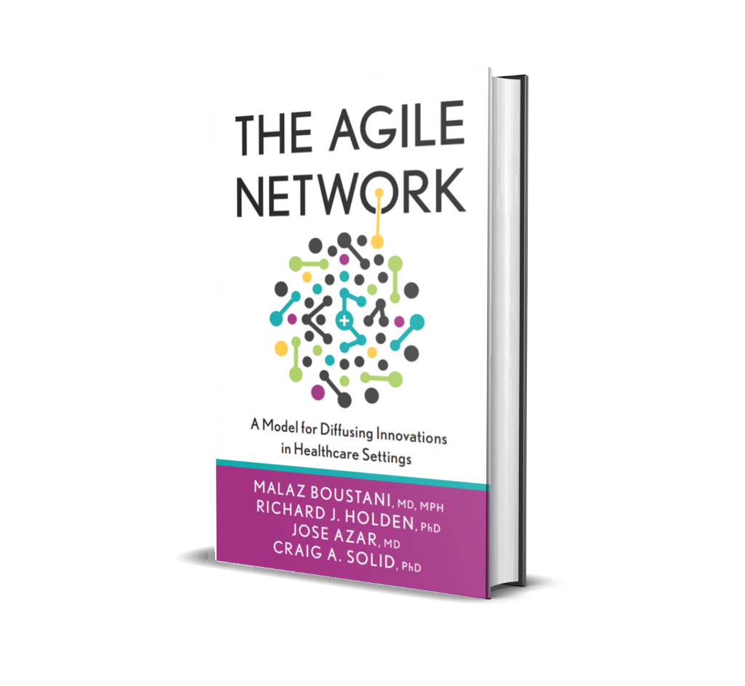
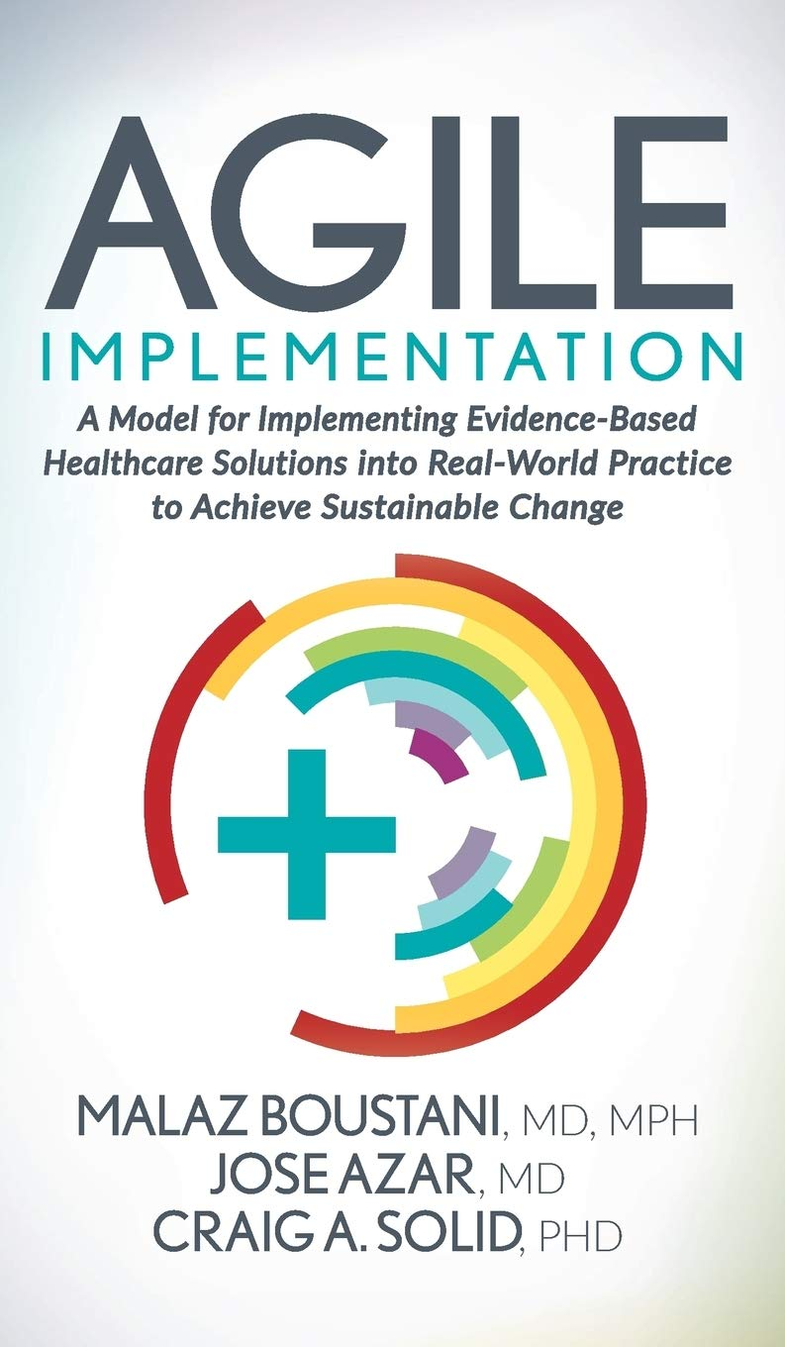
DISCLOSURE

Slide 3
Malaz Boustani
Equity Ownership in
RestUp, LLC
Preferred Population Health Management, LLC
Blue Agilis, LLC
DigiCare Realized, Inc
Advisory board member in the past 12 months for :
Biogen, Genentech, Lilly, Merck & Eisai
Author with royalty for
Agile Implementation Book; The Agile Network Book
Teacher of
IU Graduate Certificate in Innovation and Implementation Science
Scientist who receive funding from Federal agencies
NIH
AHRQ
CMS

Slide 4
The Impact Equation
ES x I x Sc x St = IS
Impactful
Solution (IS)
x
x
x
=
Effect Size (ES)
Implantability (I)
Scalability (Sc)
Sustainability(St)

Slide 6
Agile
processes

Slide 7
The Agile Cycle
Sprint 90%
Plan, Reflect & Adjust 10%
Demand

Slide 8
Agile Implementation
Part 1
The Healthy Aging Brain Center Case

Slide 9
The Healthy Aging Brain Center Case
The Need: Wishard Health Services (WHS), like all health systems, continually seeks to achieve the quadruple aim of better care and better health, lower costs, and enhanced clinical experience. Many clinicians have evidence-based ideas on how to do accomplish this, but they lack the expertise in implementation. Health systems are complex and present many challenges. The geriatric medicine program at WHS needed a way to sustainably implement their collaborative dementia care delivery model.
Implementation: With the support of leadership and the expertise of the Innovation and Implementation Science Initiative (IISI) at the Indiana University School of Medicine, Wishard Health Services applied the Agile Implementation process to deliver the Collaborative Dementia Care Model to its patients. This healthcare delivery program was named the Healthy Aging Brain Center (HABC). With the insight of the Complex Adaptive System and Reflective Adaptive Process frameworks, the project team established the protocols for implementing the care model.
Successful Outcome: Through the Healthy Aging Brain Center, patient and caregiver satisfaction increased with Wishard’s services. WHS achieved better health outcomes, according to the health indicators that were monitored throughout the project. A sustainable program was put in place to implement evidence-based care that was not previously being delivered.

Slide 10
Executive Summary
Clinical evidence abounds in today’s healthcare system, but many health systems do not leverage evidence-based best practices. In the case of Wishard Health Services, an innovative model for Dementia Care had been developed but had not yet been put into practice. In order to implement the model, leadership wanted to ensure that better health would be achieved and that the program would be able to adapt to changes over time within their complex system. Through partnering with the Center for Health Innovation and Implementation Science in 2008, a dedicated team at Wishard developed a sustainable model for implementing collaborative dementia care in their local clinic. Guided by the Agile Implementation process, the team was able to achieve target metrics and improve the quality of care for their dementia patients, which remains in existence today.

Slide 11
The Story of the Healthy Aging Brain Center
Alzheimer’s disease and related dementias (ADRD) impose a significant burden on patients and family caregivers
Two clinical trials demonstrated benefits of a collaborative care model:
Improved care
Improved satisfaction
Fewer behavioral and psychological disabilities
Lower unpaid caregiver distress and burden

Slide 12
The Need
The lack of implementation of the Collaborative Dementia Care Model at Wishard Health Services was not due to a lack of evidence supporting the care model’s validity. Two randomized controlled trials have displayed the model’s effectiveness. More specifically, this delivery model was proven to improve “quality of care, quality of life, and the behavioral and psychological symptoms of dementia for both the patient and the caregiver within a research environment” (Boustani et al, 2011). The challenge of implementing evidence-based care in any clinic is often found in localizing the solution to a chosen practice where the model has not previously been tested. That was the challenge at WHS as well. Substantial clinical practice redesign would be needed in order to effectively implement the new care model in the selected environment.

Slide 13
The Implementation
In order to bridge the gap between evidence-based research and everyday practice, the team at Wishard Health Services received support from the leaders of the Innovation and Implementation Science Initiative (IISI) at the IU School of Medicine (now called the Center for Health Innovation and Implementation Science), which provided Implementation Science tools for practically implementing the Healthy Aging Brain Center (HABC). The IISI team brought their expertise in applying the Agile Implementation process to develop a plan. As a first step in the implementation plan, IISI built a team of representatives from various disciplines involved in delivering dementia care. The team was established so that there would be a mutual understanding—or shared vision—of the goal for Wishard’s dementia care patients. The team met over a four month period bi-weekly, for two hours at a time, to work on the project and collaborate. A smaller steering team also met to monitor the overall process and make any revisions as they were needed. The meetings were conducted through the lens of the Reflective Adaptive Process to encourage discussion, feedback, and review from the diverse group of team members. Due to the complexities of making change within a healthcare system, it was a priority to create the space and time for regular meetings. The team also created an evaluation matrix for timely data for leadership to monitor the performance of the new center. The Healthy Aging Brain Center was launched on January 7, 2008. This Center was especially important, as Wishard needed a center to focus specifically on aging brain related conditions. The HABC is still currently run by the team of representatives that was established in the first step of the implementation process.

Slide 14
Aging Brains Care Model

Slide 15
MVP of the ABC
CHECK HOSPITAL
&
ER ALERTS
EVERY DAY
COORINATE WITH
INPATIENT SERVICES
Alert hospital team of presence of cognitive or mood problems
Medications conciliation
Connect with family caregiver
Request Geriatric consult (If available)
Coordinate post discharge transition
POST DISCHARGE CARE
Home visit within 72 hours of discharge
Medications conciliation
Coordinate Home Care visit
Coordinate post hospital orders
Deliver Delirium protocol and handout
ONGOING AGING
BRAIN CARE
Manage Depression
Problem Solving Therapy
Pharmacotherapy
Cognitive Behavioral Therapy
Manage Cognitive Impairment
Cholinesterase inhibitors (if needed)
D/C medications with adverse cognitive effects (Anticholinergics, Benzodiazepines, Histamine 2 antagonists)
Caregiver problem solving coaching
Medication adherence support

Slide 16
The Outcome
Finding the core essential elements of a solution is part of the Agile Implementation process. Focusing on the key elements of the Collaborative Dementia Care Model afforded the project great success in sustaining the program and experiencing positive results. Within the first year of operation of the Healthy Aging Brain Center, the model performed well across three evaluation domains, including lower utilization and higher quality indicator patterns. Improved health outcomes were reflected in the metrics as well. For example, 78% of HABC patients reached their targeted level of diabetes control, and only 14% of HABC patients with ER visits returned to the ER within one week. Only 11% of hospitalized patients were readmitted within 30 days.¹ Agile Implementation also facilitates the consistent, collaborative efforts of those involved in a project. The group that was formed at the beginning of the implementation phase was able to sustain the program long-term, because they planned their communication from the start. Due to the Center’s success, the team at Wishard Health Services is exploring how to best replicate the Healthy Aging Brain Center and the Collaborative Dementia Care Model to other healthcare systems.

Slide 17
Lessons Learned
The challenge was in operationalizing and implementing the established collaborative care model
We succeeded because our process acknowledged the complexity of the health system and the uniqueness of the individuals within.

Slide 18
Agile Implementation

Slide 19
Planning Executing
Identify and confirm demand
Identify evidence-based solutions
Develop evaluation and termination plans
Localize the minimally viable solution (MVS)
Perform implementation sprints
Monitor implementation performance
Monitor system performance
Develop minimal standardized operating procedure (MSOP)
Notes:
Identify the Right Opportunities – confirming vs. creating demand (change not only occurs from the top/down, but also from the bottom/up)
Identify the Evidence-Based Solution – start with evidence, no need to reinvent the wheel
Develop Evaluation & Termination Plan – really about the termination plan (fail fast/fail early) and then evaluating the outcome, not the intervention
Localize the Most Valuable Solution or Service – taking minimal specs of the evidence and making it work in the local environment
Implementation Sprints – where the magic happens (and where the AI Change Agent has the least involvement; the catalyst for change not necessarily the do-er)
Monitor Implementation Performance – monitoring the intervention (MVS) using feedback loops (actionable, timely, and relevant)
Monitor System Performance – looking for unintended consequences and emergent behaviors (positive or negative)
Develop the Minimal Standard Operating Procedure – this is how you sustain and spread (scale) the solutions

Slide 20
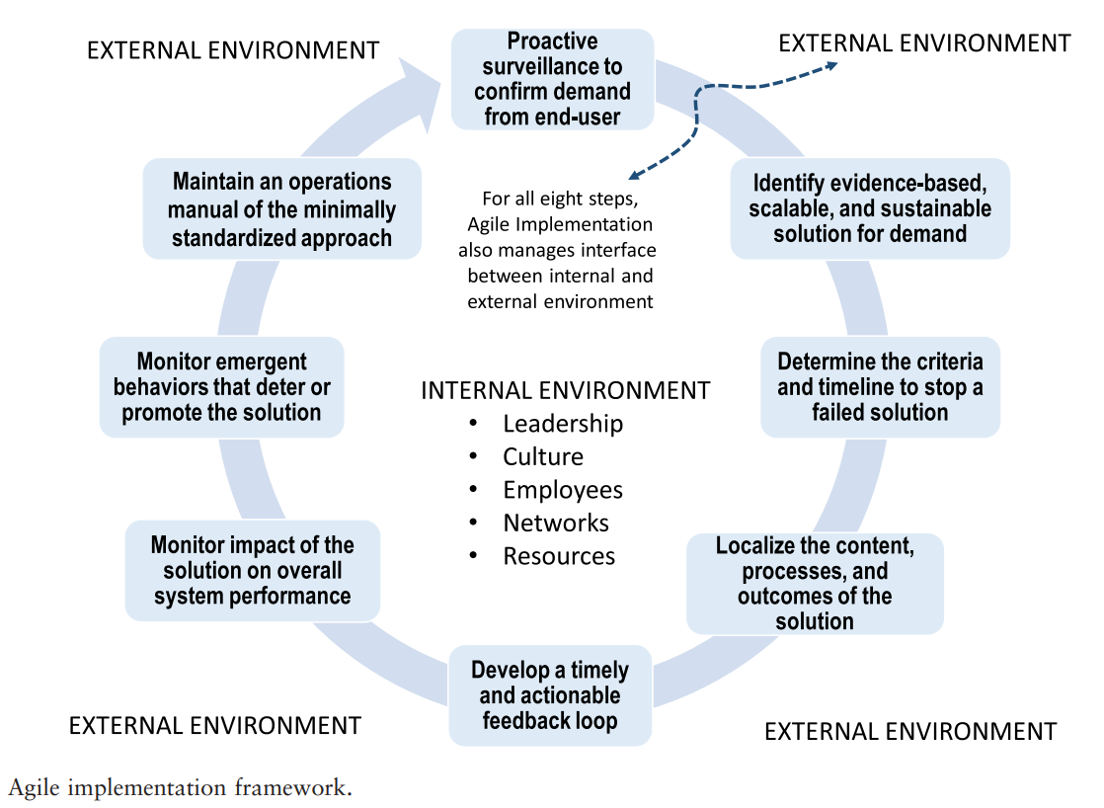
Agile Implementation in the Real World

Slide 21
Demand

Slide 22
Evaluating Demand
Level of Complexity = Capital Invested
Measuring Complexity:
Size of Network
Nonlinearity in Relationships
Sensitivity to Context and Time
4 Types of Capital:
Financial
Social
Anxiety
Time

Slide 23
Termination Plans
Termination Plans
Who will Make the Call?
When will they Decide to Make the Call or Not?
What Criteria will they use to Make the Call or Not?

Slide 24
Sprinting
Does implementing the MVP require multiple people?
Team Sprint
Do these people have to work at the same time?
YES
YES
NO
Relay Sprint
NO
How much Time needs to be spent?
___hrs x2 = ____ total hrs
(# of ppl) = __hrs per person
Block the least spaced-out amount of time to meet this # of hrs
Notes:
Does the task require multiple people?
Do these people have to be together (Team sprint) or can they work sequentially (Relay sprint)?
How much time needs to be spent (multiply estimate x2)?

Slide 25
Questions to answer when Sprinting
What is the Start Date?
What is the End Date?
What is the Evaluation Date?
Where is Data being Collected?
What is the Frequency of Data Collection?

Slide 26
Monitoring
Sprints allows early insight into successes, failures, and opportunities for modifications prior to starting the next sprint.
Adjustments are followed by additional sprint cycles with continued monitoring and reflection.
Whole-system monitoring detects unintended or adverse consequences as early as possible.

Slide 27
Minimally Standardized Operating Procedure
Minimally Standardize Operating Procedure
Develop an MSOP if evidence-based healthcare service met all internal goals.
The manual is updated on a regular basis and helps spread the successful evidence-based healthcare service across other practices and communities.
Should describe minimum requirements for implementation including how to scale and standardize the EB solution.

Slide 28
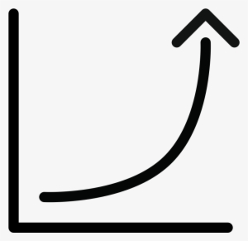
Executing Agile
Set your Minimally Viable Goal (MVG)
Set your Minimally Viable Capitals
Set your Minimally Viable Demand
Map your MVG into Minimally Viable Daily Activities
Recruit Minimally Viable Number of people to complete the daily activities.
Design the Minimally Viable Dashboard
# of humans needed
MVG Complexity

Slide 29
Agile Innovation
Part 2
The Critical Care Recovery Center Case

Slide 30
The Critical Care Recovery Center Case
The Need: With the identification of Post-Intensive Care Syndrome (PICS), a need presented itself for unifying management of long-term complications associated with critical illness. There was no existing model for delivering this type of care, so leaders at Eskenazi Health (then Wishard Health Services) identified the need for developing a way to keep their ICU admissions below the national average.
Implementation: Working with the pulmonary/critical care and geriatrics divisions at the Indiana University School of Medicine, the leadership at the Sidney and Lois Eskenazi Hospital employed methods of Implementation and Complexity Science to establish the Critical Care Recovery Center (CCRC) in 2011.
Successful Outcome: The CCRC delivered on its mission to enhance the delivery of care for ICU patients. Both the improved care and improved health outcomes will continue to contribute towards reducing the amount of patients re-hospitalized after ICU discharge.

Slide 31
Executive Summary
Innovation in the field of healthcare is always a challenge. Clinicians often have evidence-based solutions to problems that they face in their practices everyday, but the means to apply those innovations and solutions to their local environment is usually less apparent. Leadership at Eskenazi Health recognized an opportunity to better manage the care of their ICU patients, as a high percentage of ICU patients often return to the hospital with serious complications. The team at the Sidney and Louis Eskenazi Hospital endeavored to implement a new care model in the form of a Recovery Center for their patients in order to lessen the impact of Post-Intensive Care Syndrome. The hospital received implementation guidance from the leaders of Indiana University School of Medicine’s Innovation and Implementation Science Initiative (IISI), who provided the means to develop their solution into a functioning clinic. By applying the Agile Implementation process, the hospital successfully launched the Critical Care Recovery Center in 2011. Even in the early stages of operation, the Center had a positive impact on the progress of their patients’ recovery.

Slide 32
The Story of The Critical Care Recovery Center
More than 5 million patients are admitted to ICU each year in US
The stress of illness and invasive treatments can result in cognitive, physical, and psychological disabilities.

Slide 33
The Need
Intensive Care Units receive more than 5 million Americans annually, being brought in with life-threatening illnesses. Typically, as a result of these illnesses, ICU patients obtain invasive but life-sustaining treatments. Due to these treatments, some patients return with serious cognitive, physical, and psychological effects affecting their daily lives, referred to as Post-Intensive Care Syndrome. Indiana University School of Medicine, along with the Sidney and Louis Eskenazi Hospital (then Wishard Memorial Hospital), sought to prevent these major difficulties. Various approaches to follow-up care existed at the time the leadership was seeking a solution; however, none of them were identified specifically for the need of managing the set of chronic conditions often associated with critical illness. Leadership saw this as an opportunity to innovate a care model to ensure that the hospital’s ICU admissions were sustainably below the national average.

Slide 34
The Implementation
In order to develop the care model to be implemented by the Critical Care Recovery Center at Eskenazi Health, leadership drew from two important approaches that are part of the Agile Implementation Process—the Complex Adaptive System and Reflective Adaptive Process methods. Among the principles learned from these methods were important guidelines for establishing a communication plan with team members and adapting to emergent behaviors as the system undergoes change over time. By holding meetings that involved stakeholders with diverse perspectives coming from different clinical departments, the team developed a unified mission for achieving improved health outcomes. Having leadership intentionally plan for these regularly scheduled meetings created the outlets for important relationships to form. It also provided the platform for developing the main goals of the project and the required steps needed to reach those goals. The optimal physical requirements for the Center, as well as the standard operating procedures for the care teams were determined through collaborative brainstorming sessions. The Critical Care Recovery Center officially launched in 2011. Fifty-three new patients were seen by May 2012.

Slide 35
Minimally Standardized Post-ICU Care

Slide 36
The Outcome
Through the implementation of the Critical Care Recovery Center, Eskenazi Health experienced a positive impact on the Quadruple Aim of healthcare: better care and better health, lower costs, and enhanced clinical experience. Care was improved as patients benefited from the team’s original mission to maximize the recovery of ICU survivors. Significant reduction in the scores of a tool that monitors a patient’s cognitive, functional, and behavioral-psychological symptoms showed that the CCRC was having a positive impact early on by reducing the symptoms reported by patients. During the monitoring phase, data showed marked improvements within their health system. By aiming to reduce the impact of PICS on ICU patients, it is likely that ED readmissions are also avoided for patients of the Critical Care Recovery Center. The Center has made massive steps forward in innovating a model for care collaboration and believes that they will continue to make significant change in the progression and treatment of Post-intensive Care syndrome through continuous innovation and adaptation.

Slide 37
Inducing Change in Critical Care

Slide 38
Agile Innovation

Slide 39
What’s NUDGE?
Architecting the social, physical and digital environment to facilitate certain behaviors without forbidding choice.
Social
Physical
Digital
Richard H. Thaler and Cass R. Sunstein, 2008. Nudge.

Slide 40
Overall Strategy
Combining existing Building Blocks into a successful, scalable, and sustainable solution that provides high value for human everywhere.
Successful conversion depends on
The innovator DNA*
Questioning, deep observing, experimenting, networking for discovery, and association
Inclusive Diversity
Limited resources
Harvesting Luck
Agile mindset
Agile Processes
*By Jeffrey H Dyer, Hal B Gregersen, and Clayton M Christensen

Slide 41
The Agile Conductor
Think like engineers (they dissect, organize, analyze, interpret)
OR
Test like scientists (they rely on rapid empirical testing)
OR
Observe like psychologists (they leverage behavioral tendencies)
OR
Draw like artists (they create appealing mockups)
*The best ones are a combination of these

Slide 42
Agile Diffusion
Part 3
The Great Lake Practice Transformation Network Case

Slide 43
The Great Lakes Practice Transformation Case
The Need: Many innovative leaders within the healthcare system have implemented new standards of practice that are evidence-based, and improve patient outcomes. However many of these ideas do not diffuse throughout a large portion of the medical community. This is because some human networks have a degree distribution that scales to the right, meaning that many members of the network have few connections.
Implementation: A five-state coalition was formed with thirty-two healthcare partners. Operations teams in each state recruited, retained, and training clinicians. A central networking operations team and centralized consortium of faculty experts leveraged the network’s health data, connections, experience, and intellectual capital to find and diffuse innovations and best practices throughout the entire network.
Successful Outcome: The GLPTN was able to meet or exceed a number of important evaluative measures of the program. These include improving health outcomes for patients, generating over $1 billion in savings, reducing hospitalizations, reducing unnecessary tests, procedures, and opioid prescriptions, and collecting the data needed to scale exemplary practices.

Slide 44
Executive Summary
Many networks within the healthcare system have developed best practices that improve patient outcomes, reduce waste, and are capable of being scaled up. However, many of these best practices do not diffuse to many other health care provider networks. When the Center for Medicare & Medicaid Services (CMS) requested proposals to develop networks of health providers as part of the Transform Clinical Practices Initiative, Mr. Hountz, Dr. Boustani, and Dr. Kho applied and received approval to create the Great Lakes Practice Transformation Network. The GLPTN created a network across five states (Indiana, Michigan, Illinois, Kentucky, and Ohio.) This network connected thirty-two health care partners. The network assisted all healthcare partners by supporting the diffusion of best practices through networking, mentorship, and the creation of Innovation Forums. The GLPTN also provided members with tools such as the Transformational Change Toolkit, the Practice Assessment Tool, and a framework for effective feedback. Implementing these changes led to better outcomes for patients with nearly one million quality measure improvements, over one billion dollars in savings, reductions in waste, reductions in hospitalizations, increased participation in alternative payment programs, and building evidence for practice transformation.

Slide 45
The Need
Healthcare systems are complex systems built of individual people. In network science terms each individual is a node that can diffuse best practices to those whom they are connected, or through an intermediary node. This structure allows ideas to diffuse within the network, however, many networks are limited by geographical proximity and the tendency for human systems to follow the Power-Law Distribution, which means that many people within a network have very few connections and a small number of nodes have many connections. Innovative ideas will not diffuse to other health care networks unless there are individuals that act as bridges between networks. The Center for Medicaid and Medicare Services recognized this problem and supported the creation of the Great Lakes Practice Transformation Network through the Transform Clinical Practices Initiative.

Slide 46
The Implementation
The Great Lakes Practice Transformation Network was spread over five states (Indiana, Michigan, Illinois, Kentucky, and Ohio.) Within the network were five hubs, Indiana University, Purdue University, Northwestern University, Altarum Institute, and the University of Kentucky, that would serve as a way to protect the network from failing if individual practices or physicians were lost. These five hubs were connected to thirty-two healthcare partners, which included four regional extension centers, three state Departments of Health, five regional health exchanges, and eight universities. With the network planned and including multiple bridges between groups, the Great Lakes Practice Transformation Network began to engage its network. This work included strengthening the network’s connections, recruiting, retaining, and training staff. The network then worked to develop the Transformational Change Toolkit, the Practice Assessment Tool, hosting networking events, and creating Innovation Forums. All of these supports were diffused through the network.

Slide 47
Agile Diffusion Process of information in Human Networks (Agile Diffusion 1.0) From Minimally Viable Solution into Minimally Viable Story
Planning:
Get to know deeply the complex adaptive network, where the information is targeted for diffusion by
Mapping the network to detect its hubs, its narrow bridges, and its various communities.
Estimating the exponents of the power laws for both its degree and degree’s strength distribution in addition to the various moments of such distributions.
Develop agile feedback loops by embedding the right sensors and detecting the changes in network properties.
Constantly profile the various messengers for each hub, bridge and unique community.
Transform the evidence-based solution into a Minimally Viable Story. Such a story will provide the why for the creation of market demand for the innovation and allow personalization.
Executing:
Start various Sprints to identify the effectiveness of the Minimally Viable Story within each hub, bridge, and community.
Store and tag the final Minimally Viable Story within your Library for future transportability

Slide 48
The Outcome
From Sept. 29, 2015- Sept. 28, 2019, the Great Lakes Practice Transformation Network was able to achieve results that went beyond the commitments stated in the awards document in six of its seven claims. Over 13,000 clinicians enrolled in work to achieve practice transformation. There were over 970,000 clinical quality measure improvements. The program helped to generate over one billion dollars in savings. There was a reduction in hospitalization of over 62,000. Over 46,000 Unnecessary tests, procedures, and opioid prescriptions were eliminated. Lastly, Over 1,200 exemplary practices were implemented across the network. The only measure that was not met was getting practices to comple the program to participate in alternate payment models. The goal was for 75% of practices to complete the program affecting 8,625 clinicians. However, only 8,580 clinicians were affected. Specific instances where patient outcomes were improved include improving flu immunization rates, depression screenings with follow up, controlled blood pressure, and Diabetes A1C control

Slide 49
Community Incubation for Complex Contagion (Agile Diffusion 2.0)
Minimally Viable Nudge into a New Social Norm
Planning Executing
Identify the special community in the periphery of the network to incubate the targeted behaviors
Select or design then localize Minimally Viable (physical, digital or social) Nudge
Develop a termination plan for both the sprints and the entire social movement
Sprints to test the MVN and Monitor the number of people who have adopted the new behaviors.
When you reach the local tipping point of 25% of the community people adopting the new behaviors, identify people with strong ties (wide bridges) to transport the new behavior into another community.
When 25% of the entire network HUB’s contacts have adopted the new behavior, the HUB would finally adopt the new behavior and a new Social Norm will start spreading across the entire network.
Notes:
Identify the Right Opportunities – confirming vs. creating demand (change not only occurs from the top/down, but also from the bottom/up)
Identify the Evidence-Based Solution – start with evidence, no need to reinvent the wheel
Develop Evaluation & Termination Plan – really about the termination plan (fail fast/fail early) and then evaluating the outcome, not the intervention
Localize the Most Valuable Solution or Service – taking minimal specs of the evidence and making it work in the local environment
Implementation Sprints – where the magic happens (and where the AI Change Agent has the least involvement; the catalyst for change not necessarily the do-er)
Monitor Implementation Performance – monitoring the intervention (MVS) using feedback loops (actionable, timely, and relevant)
Monitor System Performance – looking for unintended consequences and emergent behaviors (positive or negative)
Develop the Minimal Standard Operating Procedure – this is how you sustain and spread (scale) the solutions

Slide 50
The Building Blocks of Diffusing a New Social Norm
The Message
ROI: 0.01 X
Control: 100 X
The behavior of the Messenger
ROI: 1.0 X
Control: 1.0 X
The development of local Social Norm
ROI: 100X
Control: 0.01 X

Slide 52
REFERENCES
Azar, J., MD, Kelley, K., MPH, Dunscomb, J., MSN, RN, Perkins, A., MS, Wang, Y., MD, Beeler, C., MD, . . . Boustani, M., MD, MPH. (2019). Using the Agile Implementation Model to reduce Central Line-Associated Bloodstream Infections. American Journal of Infection Control, 47(1), January, 33-37. doi:https://doi.org/10.1016/j.ajic.2018.07.008
Boustani, M., MD, MPH, Alder, C. A., JD, MSW, & Solid, C. A., PhD. (2018). Agile Implementation: A Blueprint for Implementing Evidence-Based Healthcare Solutions. Journal of the American Geriatrics Society, 66(7), July, 1372-1376. doi:https://doi.org/10.1111/jgs.15283
Boustani M, Unutzer J, Leykum L. Design, implement, and diffuse scalable and sustainable solutions for dementia care. JAGS 2021;69:1755-1762.
Holden RJ, Boustani MA, Azar J. Agile Innovation to transform healthcare: innovating in complex adaptive systems is an everyday process, not a light bulb event. BMJ Innov. 2021; 0:1-7. Epub ahead of print: 28 January 2021. doi:10.1136/bmjinnov-2020-000574
Boustani MA, van der Marck MA, Adams N, Azar JM, Holden RJ, Vollmar HC, et al. Developing the agile implementation playbook for integrating evidence-based health care services into clinical practice. Academic Medicine. 2019;(4):556-561. doi: 10.1097/ACM.0000000000002497.
Callahan, C. M., MD, Bateman, D. R., MD, Wang, S., MD, & Boustani, M. A., MD, MPH. (2018). State of Science: Bridging the Science-Practice Gap in Aging, Dementia and Mental Health. Journal of the American Geriatrics Society, 66(S1), S28-S35. doi:https://doi.org/10.1111/jgs.15320
Bpustani M, Azar J, Solid C. Agile Implementation: A model for implementing evidence-based healthcare solutions into real-world practice to achieve sustainable change. Published in New York, New York, by Morgan James Publishing. ISBN 978-1-64279-659-9; eBook ISBN 978-1-64279-658-2; hardcover.Library of Congress Control Number: 2019907494
Bastian H, Glasziou P, Chalmers I. Seventy-five trials and eleven systematic reviews a day: how will we ever keep up? PLoS Med 2010;7(9):e1000326. Balas E, Boren S. Yearbook of medical informatics: Managing clinical knowledge for health care improvement. Stuttgart, Germany: Schattauer Verlaggesellsschaft mbH; 2000. Green LW, Ottoson JM, Garcia C, Hiatt RA. Diffusion theory and knowledge dissemination, utilization, and integration in public health. Annu Rev Public Health 2009;30:151—74. Brownson R, Kreuter M, Barbara A, Arrington B, True W. Translating Scientific Discoveries Into Public Health Action: How Can Schools Of Public Health Move Us Forward? Public Health Reports, Vol 121, Issue 1, pp. 97 - 103, First Published January 1, 2006, https://doi.org/10.1177/003335490612100118.
Paul S. Mytelka D. Dunwiddie T. Persinger C. Munos B. Lindborg S. Schacht A. How to improve R&D productivity: the pharmaceutical industry's grand challenge. Nature Reviews Drug Discovery volume 9, pages 203–214 (2010). doi:10.1038/nrd3078.
Smith M, Saunders R, Stuckhardt L, McGinnis JM. Best care at lower cost: the path to continuously learning health care in America:. National Academies Press; 2013. Institute of Medicine. 2013. Best Care at Lower Cost: The Path to Continuously Learning Health Care in America. Washington, DC: The National Academies Press. https://doi.org/10.17226/13444.
Landrigan C, Parry G, Bones C, Hackbarth A, Goldmann D, Sharek P. Temporal Trends in Rates of Patient Harm Resulting from Medical Care. The New England Journal of Medicine 2010 Nov;363:2124—34. Ebell MH, Sokol R, Lee A, Simons C, Early J. How good is the evidence to support primary care practice? Evid Based Med 2017;22:88–92..
Boustani, M., Richard J. Holden, J. A. and Solid, C. A. (2020) The Agile Network. First edit. Edited by K. Stapley. Beaver’s Pond Press.
Signals and Boundaries: Building Blocks for Complex Adaptive Systems by John H Holland. 2012 MIT Press, Cambridge, Massachusetts. ISBN 978-0-262-01783-1.

