Slide 1
Agile Science and its Derivatives
Day 1
Richard Holden, PhD; Malaz Boustani, MD, MPH
The Faculty of the Agile Nudge University
Supported by NIA
April 2023

Slide 2
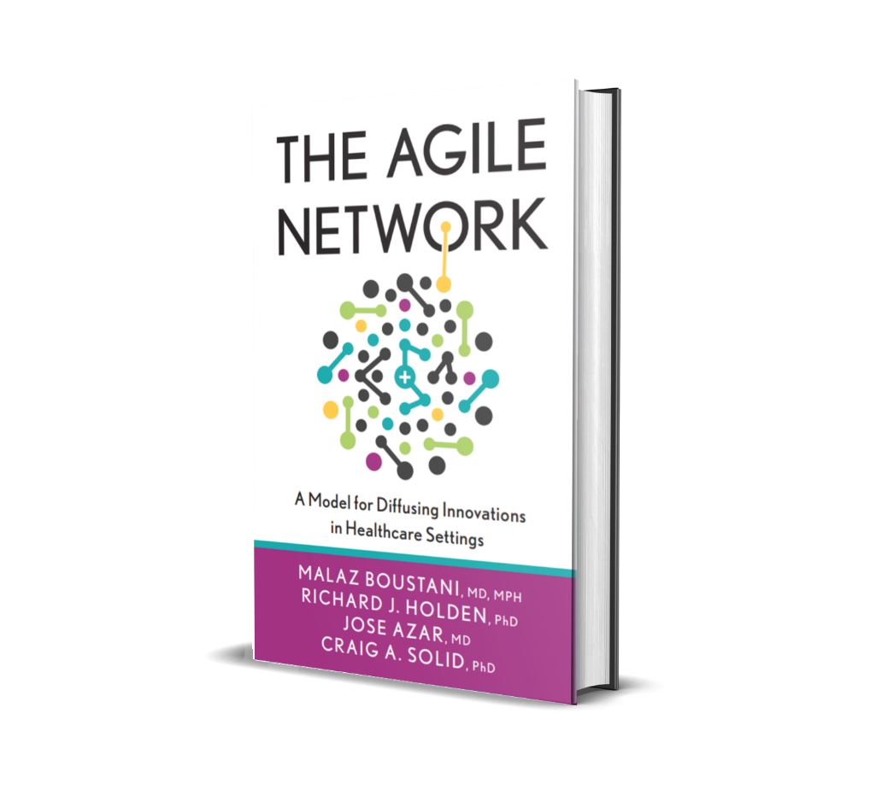

DISCLOSURE

Slide 3
Malaz Boustani
Equity Ownership in
RestUp, LLC
Preferred Population Health Management, LLC
Blue Agilis, LLC
DigiCare Realized, Inc
Advisory board member in the past 12 months for :
Biogen, Genentech, Lilly, Merck & Eisai
Author with royalty for
  Agile Implementation Book; The Agile Network Book
Teacher of
  IU Graduate Certificate in Innovation and Implementation Science
Scientist who receive funding from Federal agencies
  NIH
  AHRQ
  CMS

Slide 4




The Impact Equation
ES x I x Sc x St = IS
Impactful
Solution (IS)
x
x
x
=
Effect Size (ES)
Implantability (I)
Scalability (Sc)
Sustainability(St)

Slide 5
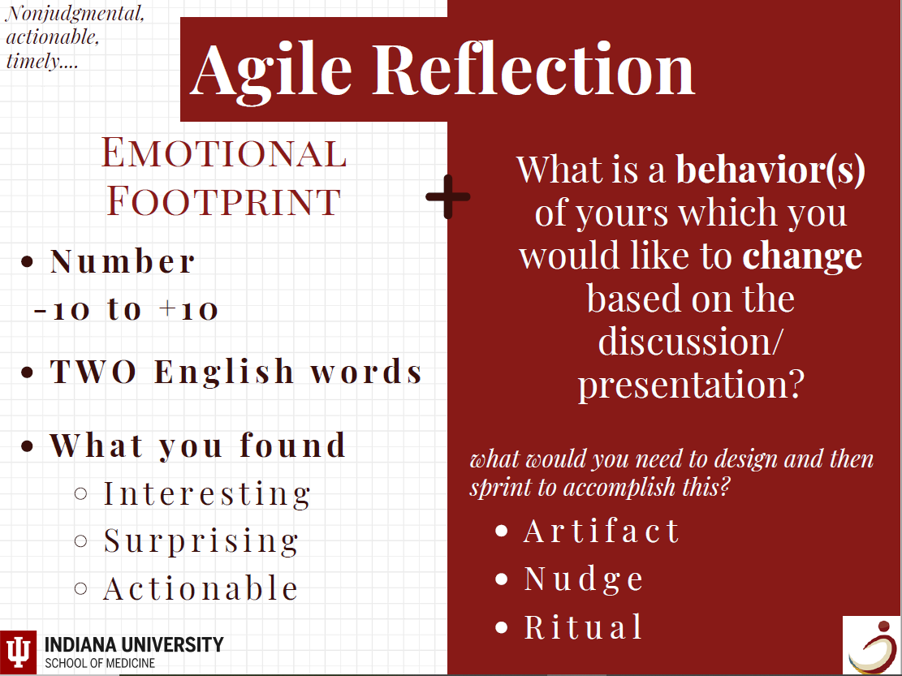

Slide 6

Introductions
Who are YOU really?
WHY are you here?
Notes:
My intro…
I’m going to ask you to put on a new set of lenses for the next 3 days
We are going on a journey. To get to where we want, we must know where we are…

Slide 7
The Naf Naf Grill Story-Healthcare 1.0
Part 1

Slide 8

Background
Naf Naf Grill is a fast-food chain emphasizing Middle Eastern Cooking. In Chicago, it is my favorite:
  Excellent Food
  Excellent Customer Service
  Customizable Orders! (Like Starbucks)
In March 2020, a new store was opened new in Carmel!

Slide 9
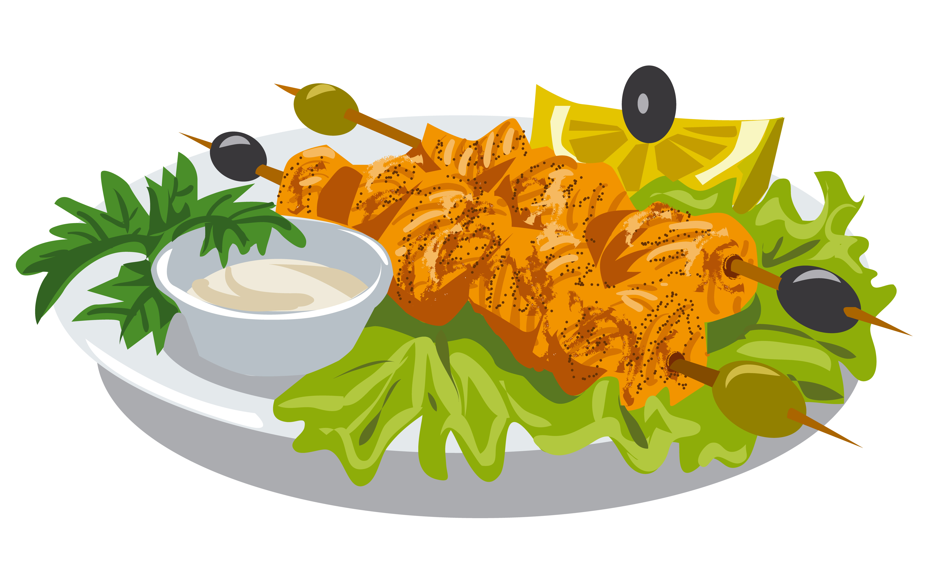
Prologue
I was hungry after 18 hours intermittent fasting and visited Naf Naf Grill. My wife loves one menu item, Chicken kabob with rice and garlic sauce. No side items.
I arrived excited. Restaurant was empty, and there were three servers up front. I placed my order, expecting the same delightful experience.

Slide 10

The Problem
The server informed me that there is one price for the chicken kabob regardless of whether he removes the sides or not. I asked to be charged less as I did not want to pay for what I did not order. I was told that the restaurant policy is to charge full price.
This is no longer a Delightful Experience, this is ‘One Size Fits All’ Ideology. There is no customization for the customer.

Slide 11

The Problem (Continued)
I felt I was treated like a number which was traumatic. This reminded me of past failures in healthcare system and where I am from (Syria).
The only solution was to ask for the manager and request change directly. Although it was not server’s fault the server ends up feeling hopeless regardless.

Slide 12
Request for Change
The Professor: Appeals to Customer Learning. Service Industry Prioritization would allow custom orders in order to promote sustainable interest and customer safety.
The Customer: Appeals to past experiences in Chicago, earned loyalty, the delightful experience.
The Business Advisor: Appeals to Naf Naf being a niche market during difficult times, ways to improve customer support and enjoyment.

Slide 13

The Result
Manager is cold, reminded me of typical doctor/ business-person who does not put the customer first.
Manager says they are franchisee but not owned by Chicago restaurant. The manager defended the policy.
Takes 15 minutes to return with corporate office number.
It did not allow me to tip staff, the staff is a prisoner of bad policy and cannot be held accountable for poor management.

Slide 14
Follow Through
I called corporate office. At this point I had spent almost 2 hours on this issue. Corporate office apologized and offered discount or membership card. This is NOT about the money.
They promise this is not the brand and they will reach out to retrain, but I asked for a follow up call within 1 week or I would share the experience with everyone. (Accountability)

Slide 15
Lessons Learned
Naf Naf began as a pleasurable experience, but the chain did not emulate those values.
Naf Naf became the enemy.
“One Size Fits All” is Healthcare 1.0, Six Sigma, Lean.
Does not take the Customer Needs into account
Agile is a customer focused solution with a hill worth dying on.

Slide 17
Agile
Part 2

Slide 18
AGILE: Ask Google?
“Able to move quickly and easily”
“Able to think and understand quickly”
“Relating to or denoting a method of project management, used especially for software development, that is characterized by the division of tasks into short phases of work and frequent reassessment and adaptation of plans”
“Agile methods replace high-level design with frequent redesign”

Slide 20
The Agile Science
Part 3

Slide 21

Agile Science
Definition: Agile science is a rapidly evolving and adaptive process for knowledge discovery and acquisition within the dynamic, constantly changing and evolving real-world.
Purpose: Agile science integrates insights from behavioral economics, complexity science, and network science to understand, predict, and steer the behaviors of both an individual human and a social organization.
Outcome: Agile science provides insights to design scalable and effective human-centered strategies, processes, and tools, implement them into routine care and subsequently diffuse them across various social networks.

Slide 22
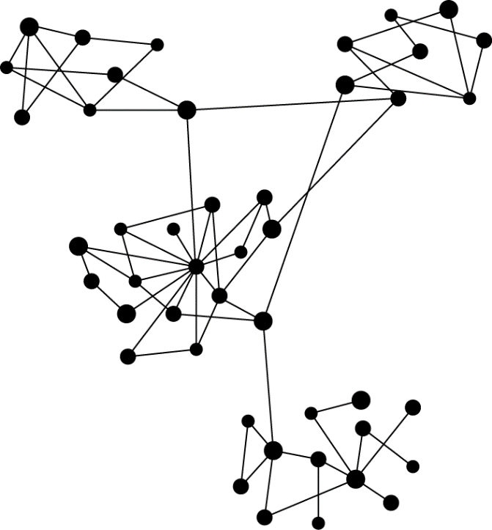

The Complex Adaptive Human Network
Node
Node
Node
Hierarchical Aggregate Agent
Agile Science:
Complex Adaptive Systems
Network Science
Behavioral Economics
Macro Level
Novel Emergent Function
The total is greater than the sum of its parts
Becomes a node in a network of a higher dimension
Conditional Interactions
(information or resource/energy exchange between individuals and their environment)
Signal exchange leading to behavioral influence
Micro Level
Complex Adaptive Systems
Semi-Autonomous Adaptive Human Agent
Network of Adaptive Agents
Operating System I (23.66 hrs) & System II (0.33 hrs)
Cognitive Biases
Nudge-able
Link
Node
Bridge
Semi-permeable Boundary
(allows certain signals in and keeps others out)
Hub
Local complex adaptive network of high concentrations of signals, resources, and co-evolving agents interacting
Behavioral Economics
Community (Social Cluster)
Network Science
Notes:
Semi-permeable
Operating System
Node
Bridges
Human Operating System

Slide 23
The Agile Pyramid
Agile
Conductor
& Strategist
Engaging Brand
Innovator, Storyteller – Nudger,
Signal Detector
Agile Cycle and Agile Processes
Agile Innovation
Agile Implementation
Agile Analytics
Agile Diffusion
Agile Science and Agile Mindset
Behavior of an Individual:
Behavioral Economics
Behavior of an Organization:
Complex Adaptive Systems, Network Science

Slide 24
The Agile Conductor
Think like engineers (they dissect, organize, analyze, interpret)
OR
Test like scientists (they rely on rapid empirical testing)
OR
Observe like psychologists (they leverage behavioral insights)
OR
Draw like artists (they create appealing mockups)
*The best ones are a combination of these

Slide 25
The Agile Mindset
Part 4

Slide 26
The Agile Mindset
Safe Culture
Feedback
Sprints of Minimally viable prototypes

Slide 27
Safe Culture
Establish a psychologically safe climate where members:
  Feel comfortable giving and receiving feedback and direction,
  Have time and space to collaborate and exchange information,
  Foster appreciation for “good enough” rather than perfect solutions.
Notes:
The first component, and perhaps the most important component of the Agile Mindset is to have a safe culture where we establish a psychologically safe climate where members
Feel comfortable giving and receiving feedback and direction,
Have time and space to collaborate and exchange information,
and Foster appreciation for “good enough” rather than perfect solutions.

Slide 28
Feedback
Embed sensors within the internal and external environment of the healthcare delivery network capable of capturing both signal and noise including gossip, rumors, and hallway conversations.
Invest in timely, nonjudgmental, and actionable feedback loops.
Activate networks of information flow, identifying information hubs, local communities, and bridges between communities, for rapid information spread.

Slide 29
Minimally Viable Prototypes
Develop minimum viable products (MVPs).
Quickly test their performance in real systems through rapid experimentation.
Conduct sprints in the target local environment to evaluate the MVP and revise based on gathered feedback.

Slide 30
The Agile Cycle
Part 5

Slide 31
The Agile Cycle
Sprint 90%
Plan, Reflect & Adjust 10%
Demand

Slide 33
What is Behavioral Economics?
Part 6

Slide 34



What is Behavioral Economics?
Thoughts and Choices are influenced by
Timing of the Environment (Context)
Digital, Social, and Physical Environment

Slide 35
Social Cognitive Theories
INPUT
Recognized or unrecognized Environmental Stimuli
System I: Automatic Cognitive Process
Rules or
Algorithm
System II: Conscious Cognitive Process
OUTPUT
Behavioral Response

Slide 36
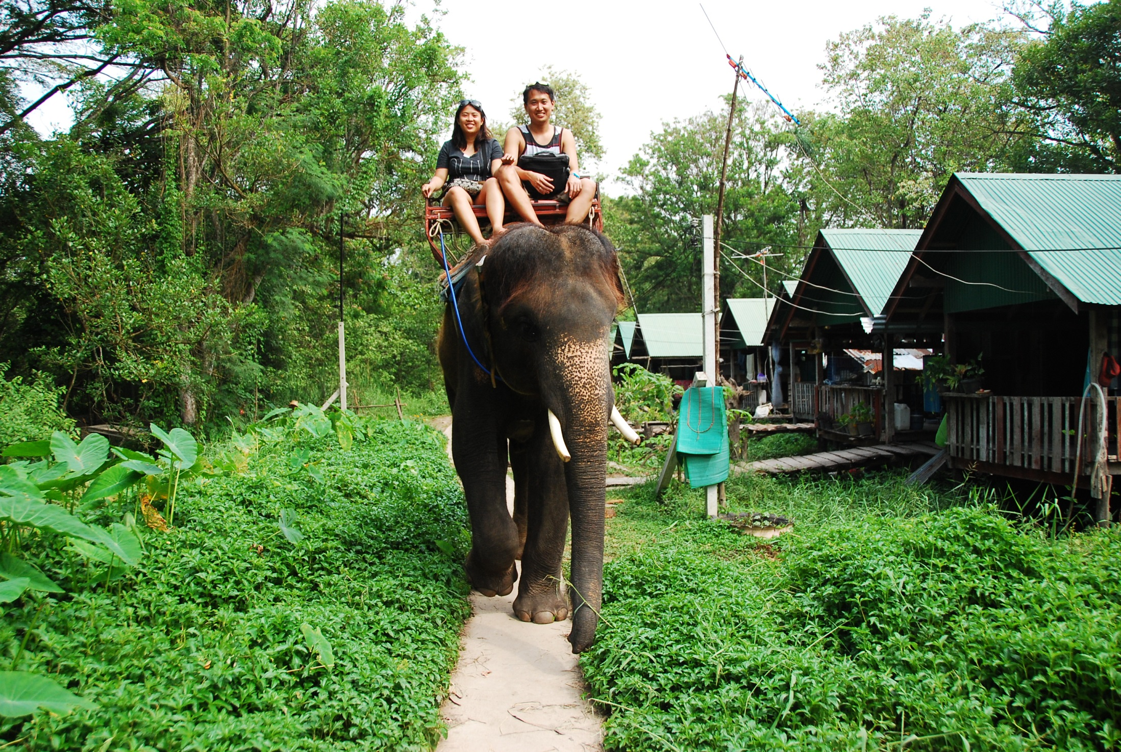
Dual Process Theory | Thinker and Doer

Slide 37
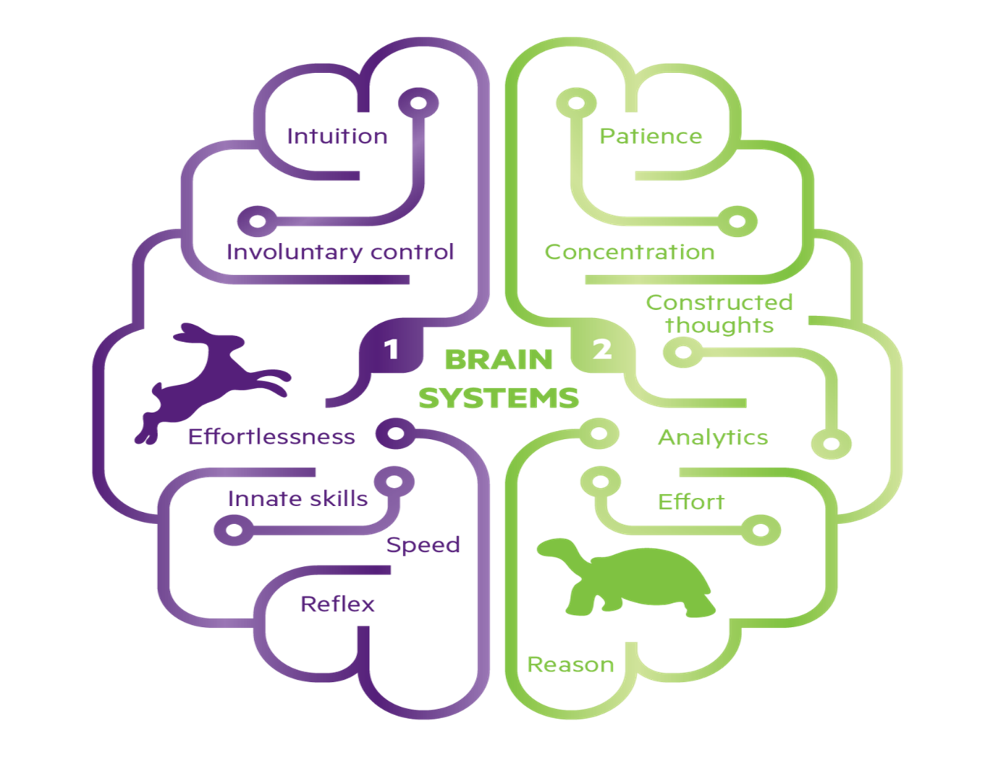
Thinking Fast and Slow

Slide 38
The Cognitive Biases of System I, Why?
Too much information: So, we aggressively filter, and noise becomes signal.
Not enough Meaning: So, we fill in the gaps and signal becomes a story.
Need to act fast: So, we jump to conclusions and stories become decisions.
What should we remember?: We try to remember important bits and decisions inform our mental models of the world
Buster Benson: https://betterhumans.coach.me/cognitive-bias-cheat-sheet-55a472476b18

Slide 39
Too much Information
  We notice things that are already primed in memory or repeated often
  Bizarre, funny, or visually striking things stick out more
  We notice when something changed
  We are drawn to details that confirm our own existing beliefs
  We notice flaws in others more easily than flaws in ourselves.
Buster Benson: https://betterhumans.coach.me/cognitive-bias-cheat-sheet-55a472476b18

Slide 40
Not Enough Meaning
  We find stories and patterns even in sparse data
  We fill in characteristics from stereotypes, generalities, and prior histories whenever there are new specific instances or gaps in information
  We imagine things and people we are familiar with or fond of as better than things and people we are not familiar with or fond of
  We simplify probabilities and numbers to make them easier to think about
  We think we know what others are thinking
  We project our current mindset and assumptions onto the past and future.
Buster Benson: https://betterhumans.coach.me/cognitive-bias-cheat-sheet-55a472476b18

Slide 41
Need to Act Fast
  In order to act, we need to be confident in our ability to make an impact and to feel like what we do is important
  In order to stay focus, we favor the immediate, relatable think in front of us over the delayed and distant
  In order to get anything done, we are motivated to complete things that we have already invested time and energy in.
  In order to avoid mistakes, we are motivated to preserve our autonomy and status in a group, and to avoid irreversible decisions.
  We favor options that appear simple or that have more complete information over more complex, ambiguous options
Buster Benson: https://betterhumans.coach.me/cognitive-bias-cheat-sheet-55a472476b18

Slide 42
What Should We Remember?
  We edit and reinforce some memories after the fact
  We discard specifics to form generalities
  We reduce events and lists to their key elements
  We store memories differently based on how they were experiences.
Buster Benson: https://betterhumans.coach.me/cognitive-bias-cheat-sheet-55a472476b18

Slide 43
System I vs System II
Low effort
Little awareness
Low Motivation
$ Cheap
Much effort
High Awareness
HIGH Motivation
$$$$Very Expensive
Some effort
Some Awareness
Some Motivation
$$Some expenses
HIGH Scalability and Sustainability LOW
Habit
Mimicry
Heuristics
Intuition
Choice
Architecture
Nudges
Education
Coaching
Daniel Clark, IU Center for Aging Research

Slide 44
References
Part 6

Slide 45
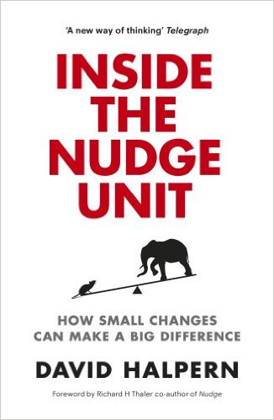

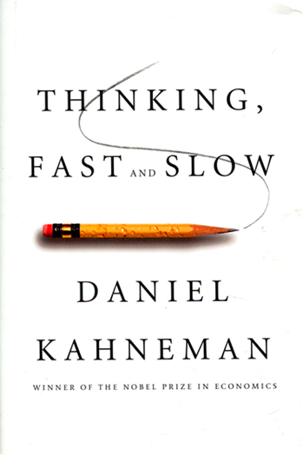

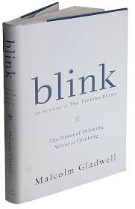
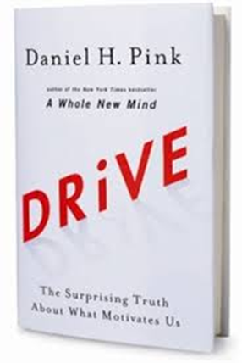
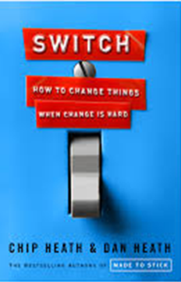
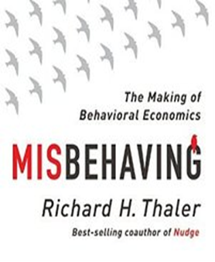
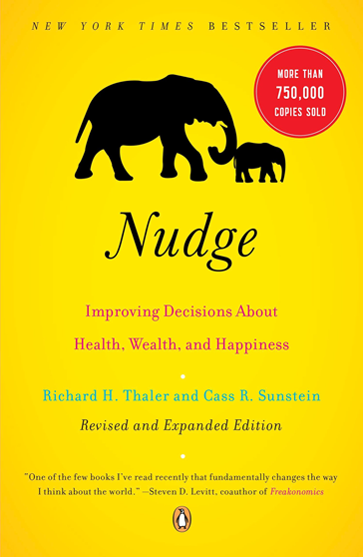
Recommended Books I

Slide 46


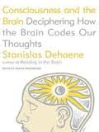

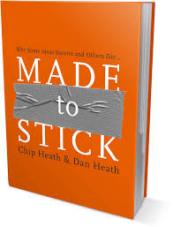
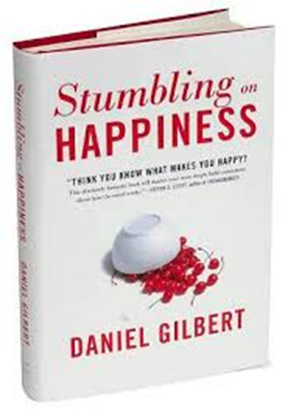



Recommended Books II

Slide 47

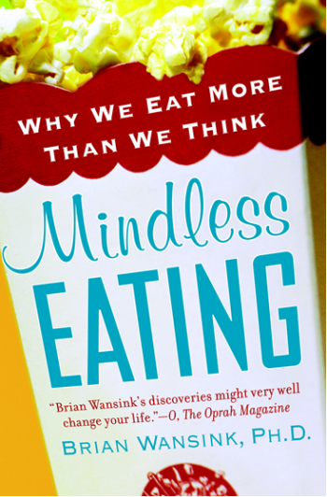

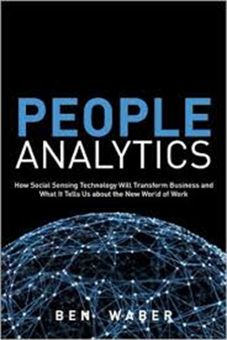



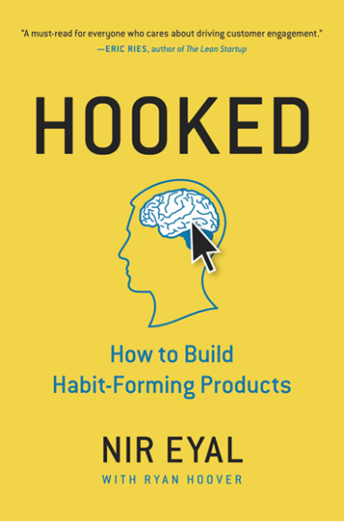
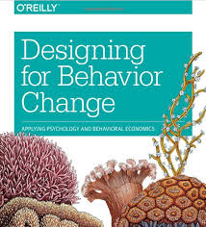
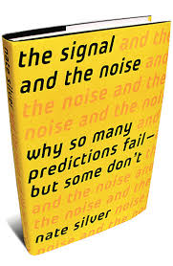
Recommended Books III

